Slide 1
ALS, amyotrophic lateral sclerosis, MND: motor neuron disease

Slide 2
Disclosure of Commercial Support
Financial support for the development of this educational program was provided by Mitsubishi Tanabe Pharma Canada.
Potential conflicts of interest:
SPEAKER NAME received compensation from Mitsubishi Tanabe Pharma Canada as an honorarium
The members of the Scientific Committee have received compensation from Mitsubishi Tanabe Pharma Canada
Notes:
NOTE TO SPEAKER/FACILITATOR:
Please ensure your name is included on this slide.

Slide 3
Speaker Disclosures
Speaker:
Relationships with commercial interests:
Research grants:
Speakers’ Bureau/Honoraria/Grant:
Consulting fees:
Other:
Notes:
NOTE TO SPEAKER/FACILITATOR:
Please complete this slide.

Slide 4
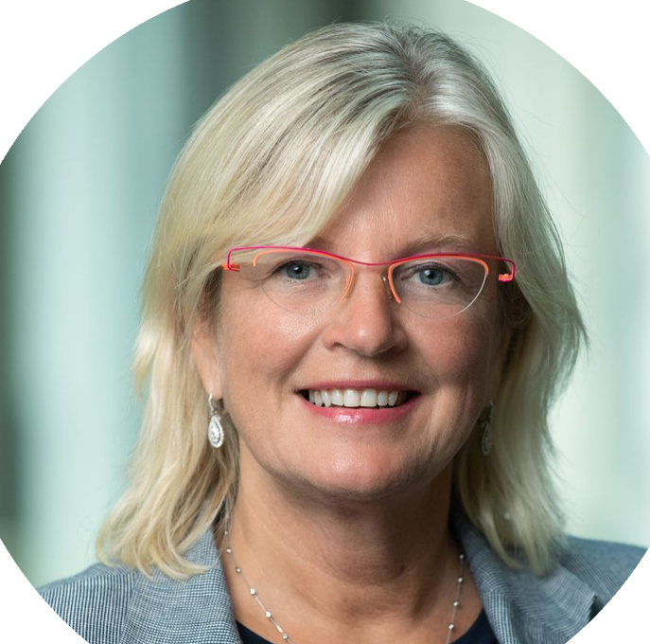
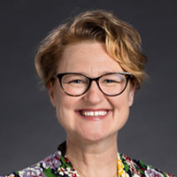
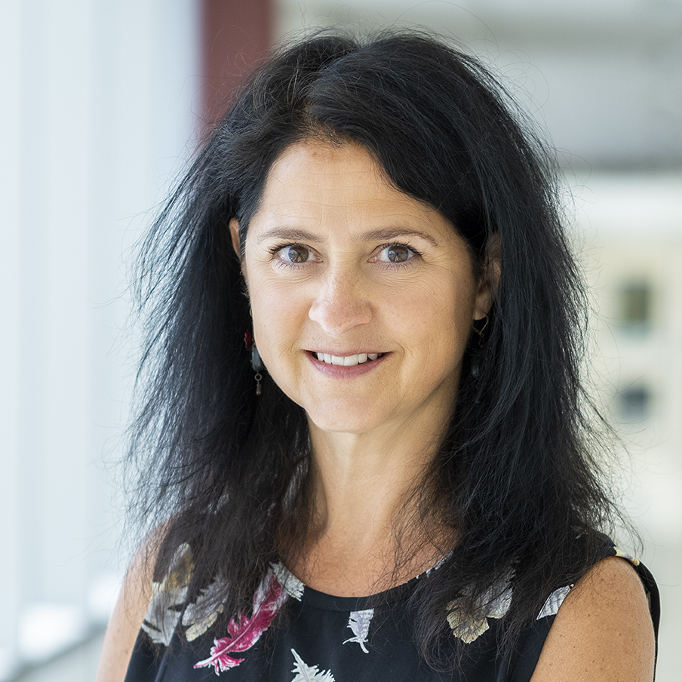
Program Faculty
CHAIR
Angela Genge MD, FRCP(C)
Director, Clinical Research Unit
Montreal Neurological Institute
Associate Professor
Department of Neurology and Neurosurgery
McGill University Montreal, Quebec
Melinda S. Kavanaugh PhD, MSW, LCSW
Professor, Social Work
Department of Social Work
University of Wisconsin-Milwaukee
Milwaukee, Wisconsin
Colleen O’Connell MD, FRCPC
Medical Director & Research Chief
Stan Cassidy Centre for Rehabilitation
Clinical Research Director
Centre for Adaptive Rehabilitation Engineering Institute of Biomedical Engineering
University of New Brunswick
Assistant Professor
Dalhousie University Faculty of Medicine
Dalhousie Medicine New Brunswick
Fredericton, New Brunswick
Cathy Cummings CAE, MBA
Executive Director
International Alliance of ALS/MND Associations
Coldwater, Ontario

Slide 5
Faculty Member Disclosures
Relationships with commercial interests | Angela Genge, MD, FRCP(C) | Colleen O’Connell, MD, FRCPC | Melinda S. Kavanaugh, PhD, MSW, LCSW | Cathy Cummings, CAE, MBA
Research grants | Target ALS, Quralis | Alexion, Annexo, Calico, Cytokinetics, IPSEN, MT Orion, Pharma Roche | National Institutes for Health (NIH), ALS Association, Administration on Community Living (ACL) | -
Speakers’ Bureau/Honoraria/Grant | Amylyx, Biogen, Calico, Cytokinetics, Eledon, Lilly, MTPA, MT Canada, Regeneron, UCB | Allergan, Biogen, IPSEN, MT Pharma | ALS Association | -
Consulting fees | AL-S Pharma, Amylyx, Calico, MTPA, Quralis | Amylyx, Biogen, Cytokinetics, Innomar, IPSEN, MT Pharma, Roche | - | -
Other |  |  | - | -

Slide 6
Disclaimer
This committee has voluntarily removed the word bad from the communication skill of delivering bad news in ALS/MND. Whereas, there will always be an element of suffering and challenge when speaking of an ALS diagnosis and/or disease progression, qualifying this as only “bad” news could potentially prime all parties to “only” focus on the BAD components.

Slide 7
Learning Objectives
Describe the impact delivering news in ALS/MND can have on patients, caregivers and healthcare professionals
Identify and address personal biases and perspectives on ALS/MND, death and dying
Recognize and apply best practices in delivering news to people living with ALS/MND and their caregivers
Respond to patient/caregiver distress when receiving the news
Apply the A-L S-PIKES technique in clinical practice to improve confidence and comfort in delivering news
ALS, amyotrophic lateral sclerosis; MND, motor neuron disease

Slide 8
Question
?
How comfortable are you in delivering challenging news to people living with ALS/MND?
Not at all comfortable
Very comfortable
ALS, amyotrophic lateral sclerosis; MND, motor neuron disease

Slide 9
Question
?
Describe in a few words how you feel when delivering challenging news to people living with ALS/MND
ALS, amyotrophic lateral sclerosis; MND, motor neuron disease

Slide 10
Why was this program created?

Slide 11
A Caregiver's Experience Receiving the Diagnosis
Your ALS Guide. Receiving an ALS Diagnosis from a Neurologist. Available at: https://www.youralsguide.com/allison-bulat-interview.html Accessed on November 17, 2022.
Notes:
SPEAKER NOTES:
Please share this short video in which an ALS/MND caregiver shares her experience receiving her husband’s diagnosis.
This video highlights the need for a program focussing on how to deliver difficult news appropriately and effectively to people living with ALS/MND and their caregivers/families.

Slide 12
What is “Bad” News?
“
“Bad” news is any news that seriously and adversely affects the patient’s view of his or her future.
– Robert Buckman, 1992
“
Buckman R. How to Break Bad News: A Guide for Health Care Professionals. Baltimore: Johns Hopkins University Press. 1992.
Notes:
SPEAKER NOTES:
In his book, Breaking Bad News: A Guide for Health Care Professionals, the late renowned oncologist and interpersonal communications expert, Dr. Robert Buckman, defined bad news as “any information, which adversely and seriously affects an individual's view of his or her future”.
Conveying difficult news to patients is an arduous and emotionally challenging task for healthcare professionals (HCPs), and many feel that they are not well prepared for this task given that medical training curricula devoted to this area are limited.
Reference:
Buckman R. How to Break Bad News: A Guide for Health Care Professionals. Baltimore: Johns Hopkins University Press. 1992.

Slide 13
The Task of Breaking Difficult or “Bad” News
“
The task of breaking “bad” news is a testing ground for the entire range of our professional skills and abilities. If we do it badly, the patients or family members many never forgive us; if we do it well, they will never forget us.
– Robert Buckman, 1992
“
Buckman R. How to Break Bad News: A Guide for Health Care Professionals. Baltimore: Johns Hopkins University Press. 1992.
Notes:
SPEAKER NOTES:
This quote taken from Dr. Buckman’s book emphasizes the skill required in delivering difficult news to patients. If not performed appropriately, the effect can be devastating, leaving the patient with a sense of abandonment and destroying the patient–physician relationship.
Reference:
Buckman R. How to Break Bad News: A Guide for Health Care Professionals. Baltimore: Johns Hopkins University Press. 1992.

Slide 14
What are the Barriers to Breaking News?
Healthcare professionals that deliver challenging news often experience:
Strong emotions, such as anxiety
A burden of responsibility for the news
Fear of patients’/ caregivers’ emotional reactions to the news
Fear of negative evaluation by the patient and family
This stress creates a reluctance to deliver the news – the “MUM” effect – and can lead to delays in delivering a diagnosis and/or follow-up care.
Adapted from: Baile W, et al. Oncologist 2000;5:302-311. Buckman R. Community Oncology 2005;2:138-42.
Notes:
SPEAKER NOTES:
Healthcare professionals that deliver difficult news often report experiencing strong emotions, such as anxiety, a burden of responsibility for the news, fear of patients’ emotional reactions to the news, as well as fear of negative evaluation by the patient and/or family.
This stress can lead to a reluctance to deliver difficult news, which has been termed the “MUM” effect. The “MUM” effect can lead to a delay in diagnosis and/or follow-up care while delivery of the news is avoided.
In fact, some healthcare professionals fail to deliver difficult news and actually refer the patient to another physician or healthcare professional for delivery of the news. Some patients with ALS/MND have found out about their diagnosis by “googling” the name of the physician they were being referred to.
References:
Baile WF, et al. SPIKES-A six-step protocol for delivering bad news: application to the patient with cancer. Oncologist. 2000;5:302-11.
Buckman R. Breaking bad news: the S-P-I-K-E-S strategy. Community Oncology 2005;2:138-42.

Slide 15
Unique Challenges to Delivering News in ALS/MND
Unlike oncologic diagnoses (which often have substantial treatments and often a cure), ALS/MND remains progressive and fatal even despite extensive biomedical research and availability of clinical trials
People living with ALS/MND receive challenging news at various time points throughout the disease trajectory:
Early in the disease when they learn of their diagnosis but are still highly functional
As the disease progresses and function continues to decline
Late in the disease when palliation, dying and advanced directives need to be discussed
Ineffective communication at this stage causes emotional trauma and compromises QoL
Ineffective communication at the later stages may cause unrealistic expectations, unpreparedness, and respiratory crises
All of this is further complicated by the fact that the disease manifestations of ALS/MND are markedly heterogeneous
ALS, amyotrophic lateral sclerosis; MND, motor neuron disease; QoL, quality of life
Adapted from: Edwards WF, et al. Neurol Clin Pract. 2021;11:521-26.
Notes:
SPEAKER NOTES:
The majority of literature examining the effects of patient-physician communication of difficult news has focused on oncologic diagnoses, which often have substantial treatments and often a cure. This is fundamentally different from amyotrophic lateral sclerosis/motor neuron disease (ALS/MND), which remains progressive and fatal (usually from respiratory insufficiency) in essentially all cases even despite extensive biomedical research, new medications, and availability of clinical trials.
Furthermore, people living with ALS/MND often receive difficult news throughout the disease trajectory. Early in the disease, they typically learn of their diagnosis when they are still highly functional. Ineffective communication at this early stage may cause emotional trauma, and the patient’s quality of life may be compromised by post-traumatic stress disorder.
Then, later in the disease, after a variable period of time usually ranging between 1 and 3 years, they must formally reckon with the prognosis, and these discussions often involve respiratory failure, goals of care, palliation, dying, and advanced directives. Ineffective communication in the later stages may cause unrealistic expectations, unpreparedness, and respiratory crises.
All of this is further complicated by the fact that the disease manifestations of ALS/MND are markedly heterogeneous. It is often challenging even for experienced ALS/MND physicians to predict a timeline for patient prognosis. Furthermore, patients receive perceived “good news” along the way (e.g., the MRI was normal, blood work was normal) and so they can get their hopes up that things are going to be alright. Eventually, however, the disease progresses and functioning declines.
Reference:
Edwards WF, et al. Delivering Bad News in Amyotrophic Lateral Sclerosis: Proposal of Specific Technique ALS ALLOW. Neurol Clin Pract. 2021;11:521-26.

Slide 16
How a Diagnosis is Delivered is a Source of Discontent for Many People Living with ALS/MND and Caregivers¹
Surveys of people living with ALS/MND and their caregivers have shown that:
50%
41%
33%
75%
were dissatisfied by the manner in which the diagnosis was communicated²
received insufficient information at the time of diagnosis³
Were not given a contact for follow-up³
had questions that arose immediately after they received the initial diagnosis⁴
ALS, amyotrophic lateral sclerosis; MND, motor neuron disease
1. Shoesmith C, et al. CMAJ. 2020;192:E1453-E1468. 2. McCluskey L, et al. Amyotroph Lateral Scler Other Motor Neuron Disord. 2004;5:131-5.
3. Peters M, et al. J Health Serv Res Policy. 2013;18:28-33. 4. Abdulla S, et al. Amyotroph Lateral Scler Frontotemporal Degener 2014;15:505–12.
Notes:
SPEAKER NOTES:
The manner in which the diagnosis of ALS/MND is delivered is a source of discontent for many people living with ALS and their caregivers. In surveys of people with ALS/MND and their caregivers:
Half stated that they are dissatisfied by the manner in which the diagnosis had been communicated;
Over 40% indicated that they received insufficient information;
One-third stated that they were not given a contact for follow-up; and
75% had questions that arose immediately after they received the initial diagnosis.
References:
Shoesmith C, et al. Canadian best practice recommendations for the management of amyotrophic lateral sclerosis. CMAJ. 2020;192:E1453-E1468.
McCluskey L, et al. Breaking the news: a survey of ALS patients and their caregivers. Amyotroph Lateral Scler Other Motor Neuron Disord. 2004;5:131-5.
Peters M, et al. Patients' experiences of health and social care in long-term neurological conditions in England: a cross-sectional survey. J Health Serv Res Policy. 2013 Jan;18(1):28-33.
Abdulla S, et al. Information needs and information-seeking preferences of ALS patients and their carers. Amyotroph Lateral Scler Frontotemporal Degener. 2014;15:505–12.

Slide 17
A Caregiver's Perspective on How Challenging Delivering a Diagnosis Must be for Clinicians
Your ALS Guide. Receiving an ALS Diagnosis from a Neurologist. Available at: https://www.youtube.com/watch?v=8Kl-KuuJB1k Accessed August 16, 2022.
Notes:
SPEAKER NOTES:
In this video, the ALS/MND caregiver acknowledges how difficult and challenging the task of delivering a diagnosis must be for clinicians.

Slide 18
The Good News!
Delivering news in ALS/MND or in any other clinical situation is a skill that can be learned and improved upon by:
Breaking this news effectively can improve patient well-being and QoL
Clinicians who are comfortable with delivering challenging news are less subject to stress and burnout
Learning how to deliver the news effectively can improve overall clinical skills and interactions with patients and families
Understanding the process involved
Approaching it as a stepwise procedure
Applying well-established principles of communication and counseling
ALS, amyotrophic lateral sclerosis; MND, motor neuron disease; QoL, quality of life
Adapted from: Baile W, et al. Oncologist 2000;5:302-311. Buckman R. Community Oncology 2005;2:138-42.
Notes:
SPEAKER NOTES:
The “good news” about the task of breaking difficult news is that this is a skill that can be improved upon by understanding the process involved and approaching it as a stepwise procedure, applying well-established principles of communication and counseling.
Breaking difficult news effectively has been associated with improved patient well-being and quality of life. In addition, clinicians who are comfortable in delivering difficult news to patients are less subject to stress and burnout.
Finally, learning to deliver difficult news effectively can improve overall clinical skills and interactions with patients and families.
References:
Baile WF, et al. SPIKES-A six-step protocol for delivering bad news: application to the patient with cancer. Oncologist. 2000;5:302-11.
Buckman R. Breaking bad news: the S-P-I-K-E-S strategy. Community Oncology 2005;2:138-42.

Slide 19
Practical Protocols Are Available for HCPs
SPIKES¹ | ABCDE² | BREAKS³ | ALS ALLOW⁴
Setting Patient perception Invitation to give information Knowledge Explore emotions and empathize Strategy and summarize | Advance preparation Build environment/ relationship Communicate well Deal with reactions Encourage and validate emotions | Background Rapport Explore Announce Kindling Summarize | Ascertain Leave opportunity Stratify Anchor Let it be Listen in silence Offer over time Work together
Although each of these protocols have different acronyms, they share similar elements. Healthcare providers can choose to use whichever protocol resonates most with them (or no protocol at all) but it is important that the key elements that will be discussed in this program are followed in order to effectively deliver the news.
1. Baile W, et al. Oncologist 2000;5:302-311. 2. Rabow MW, McPhee SJ. West J Med. 1999;171:260–263.
3. Narayanan V, et al. Indian J Palliat Care 2010;16:61–65. 4. Edwards WF, et al. Neurol Clin Pract. 2021;11:521-526.
Notes:
SPEAKER NOTES:
There are several models/protocols available for delivering difficult news (see slide). Although each of the protocols has different acronyms, they all commonly promote the importance of preparation prior to the session, gaining an understanding of what the patient knows and how much they want to know, clear communication, and addressing their concerns and emotions with empathy.
SPIKES is one of the most frequently used protocols and has been studied in ALS/MND. Hence, the Program Faculty has chosen this protocol, and has made some minor adaptations (see next slide).
References:
Baile WF, et al. SPIKES-A six-step protocol for delivering bad news: application to the patient with cancer. Oncologist. 2000;5:302-11.
Rabow MW, McPhee SJ. Beyond breaking bad news: how to help patients who suffer. West J Med. 1999;171:260–263.
Narayanan V, Bista B, Koshy C. “BREAKS” protocol for breaking bad news.
Indian J Palliat Care 2010;16:61–65.
Edwards WF, et al. Delivering Bad News in Amyotrophic Lateral Sclerosis: Proposal of Specific Technique ALS ALLOW. Neurol Clin Pract. 2021;11:521-526.

Slide 20
A-L S-PIKES Protocol for Delivering News in ALS/MND (at diagnosis and throughout the disease course)
A Advance Preparation
L S Location & Setting
P Patient’s Perceptions
I Invitation
K Knowledge
E Empathy/Emotions
S Strategy & Summary
This program will focus on delivering news in the early stage of ALS/MND (i.e., delivery of diagnosis and “aftermath” period). However, these communication skills can be used at other time points throughout the disease trajectory by all ALS/MND team members.
What needs to be communicated at different stages differs, but the skills for communicating are essentially the same.
This protocol has been adapted from the SPIKES protocol developed for delivering oncologic diagnoses.
ALS, amyotrophic lateral sclerosis; MND, motor neuron disease
Adapted from: Baile W, et al. Oncologist 2000;5:302-311. Buckman R. Community Oncology 2005;2:138-42.
EFNS Task Force on Diagnosis and Management of Amyotrophic Lateral Sclerosis. Eur J Neurol. 2012;19:360-75.
Notes:
SPEAKER NOTES:
The A–L S–PIKES protocol shown here has been adapted by the Program Faculty from the SPIKES protocol that was originally developed to enable physicians to deliver news about cancer in a patient-centered manner.^{1,2}
Each step of the A–L S–PIKES protocol will be discussed in detail in this program. Note that these steps also incorporate many of the European Federation of Neurological Societies’ (EFNS’s) recommendations on how to communicate an ALS/MND diagnosis to patients, which are also referred to in the Canadian best practice recommendations for the management of ALS.^{3,4}
Please emphasize to program participants that this protocol can be used for delivering news both at the time of diagnosis of ALS/MND as well as throughout the disease course by all members of the ALS/MND team.
References:
Baile WFet al. SPIKES-A six-step protocol for delivering bad news: application to the patient with cancer. Oncologist. 2000;5:302-11.
Buckman R. Breaking bad news: the S-P-I-K-E-S strategy. Community Oncology 2005;2:138-42.
EFNS Task Force on Diagnosis and Management of Amyotrophic Lateral Sclerosis: Andersen PM, Abrahams S, Borasio GD, et al. EFNS guidelines on the clinical management of amyotrophic lateral sclerosis (MALS)--revised report of an EFNS task force. Eur J Neurol. 2012;19:360-75.
Shoesmith C, et al. Canadian best practice recommendations for the management of amyotrophic lateral sclerosis. CMAJ. 2020;192:E1453-E1468.

Slide 21
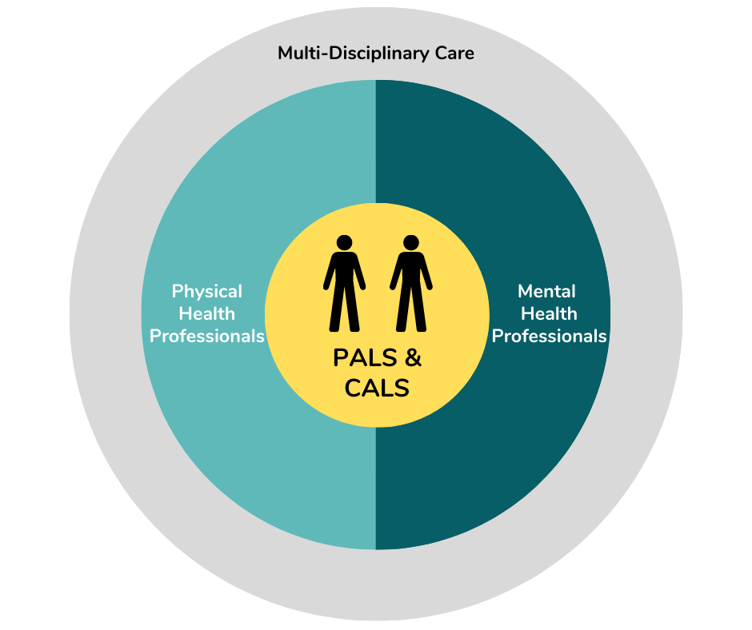
REMINDER: Both PALS & CALS are at the Centre of the Multidisciplinary Care Model in ALS/MND
Multidisciplinary Care
Recognize the different roles that members of the patient’s informal support network (spouse, partner, children, grandchildren, loved ones, friends) may play and how the news affects them
Engagement of both the patient and caregiver is essential when communicating news
ALS, amyotrophic lateral sclerosis; MND, motor neuron disease; PALS, person living with ALS; CALS, caregiver of a person living with ALS
Notes:
SPEAKER NOTES:
Please remind program participants that both the person living with ALS and the person’s caregiver are at the centre of the multidisciplinary care model in ALS/MND. Therefore, their engagement is essential when communicating difficult news both at the time of diagnosis and throughout the disease trajectory.
It is also important to recognize the different roles that the various members of the patient’s informal support network (e.g., spouses, partners, children, grandchildren, friends) play and how the news may affect these people as well.

Slide 22
A – Advance Preparation
Prepare for the discussion, both logistically and emotionally
“Know thyself” before the meeting – but also before doing this work
Identify your own personal perceptions/biases about the disease, death and dying
HCPs may make assumptions about what they “need to say” or “how they need to say it” without first processing their own perspectives or biases that could potentially lead to ineffective communication
Know the patient before the meeting, including:
Case history, all relevant test results and clinical information
Emotional and social situation
Family support
Have all the facts on hand during the conversation
HCPs, healthcare professionals
Adapted from: Baile W, et al. Oncologist 2000;5:302-311. Buckman R. Community Oncology 2005;2:138-42.
EFNS Task Force on Diagnosis and Management of Amyotrophic Lateral Sclerosis. Eur J Neurol. 2012;19:360-75.
Notes:
SPEAKER NOTES:
The first step in the A-LS-PIKES protocol for delivering difficult news is Advance preparation (i.e., preparing for the meeting both logistically and emotionally).
Before seeing the patient, it is important to identify your own personal perceptions and/or biases about ALS/MND, death and/or dying that could impact your delivery of the news. Exercises for helping healthcare professionals identify these potential biases are provided on the following slides.
It is also important to ensure that you have familiarized yourself with the patient’s case history, clinical information, all relevant test results, as well as the patient’s emotional and social situation and available family support.
References:
Baile WF, et al. SPIKES-A six-step protocol for delivering bad news: application to the patient with cancer. Oncologist. 2000;5:302-11.
Buckman R. Breaking bad news: the S-P-I-K-E-S strategy. Community Oncology 2005;2:138-42.
EFNS Task Force on Diagnosis and Management of Amyotrophic Lateral Sclerosis:, Andersen PM, Abrahams S, Borasio GD, et al. EFNS guidelines on the clinical management of amyotrophic lateral sclerosis (MALS)--revised report of an EFNS task force. Eur J Neurol. 2012;19:360-75.

Slide 23
“Know Thyself” Exercise
We all have biases about many topics, including illness, death and dying
As professionals, we are told to leave these biases at the door, but we don’t always give ourselves the time to ask What do I think? What do I believe?
What does death/dying mean to you?
Take a moment to answer these questions. Write it down. Talk it out. Acknowledge your biases.
Religious or spiritual influences?
Have you been a part of someone's dying process?
Courtesy of Dr. Melinda S. Kavanaugh. University of Wisconsin-Milwaukee. Milwaukee, Wisconsin.
Notes:
SPEAKER NOTES:
This exercise can help healthcare professionals identify any personal perceptions and/or biases that they may have toward death and/or dying which could impact their delivery of difficult news to people living with ALS/MND and their caregivers.
A short video of Dr. Kavanaugh explaining this exercise is provided (see next slide). Please review this video prior to the session and, if time permits during the session, please share this video with program participants.

Slide 24
“Know Thyself” Before the Meeting
Notes:
SPEAKER NOTES:
In this 2-minute video, Dr. Melinda Kavanaugh explains the importance of “knowing thyself” before breaking news to patients, and also explains the mindfulness exercise on the previous slide. Please review this video prior to the session and, if time permits during the session, please share this video with program participants.

Slide 25
“Know Thyself” Mindfulness Exercise
Identify
What factors may be influencing my emotions affecting how I communicate news/diagnosis/progression in ALS/MND
Monitor
For your own signs and feelings – sadness, anxiety, fear, etc.
Name
Name the emotion – whatever it may be. It may change when repeating this exercise
Sources
What are the possible sources of the emotions?
Respond
Take a step back to get perspective
Identify any behaviours that may come out of the feeling (avoidance, wanting to rescue, feeling powerless or powerful)
Think about how these behaviours have consequences with the diagnosis delivery
What alternatives exist? Who can you add to the process?
Consult with a trusted colleague or mentor
Takes 5-7 minutes, but can be completed in small chunks throughout your day
Find a space that is comfortable for you, but does not need to be anywhere specific
Write out responses, or not
Suggested for all healthcare professionals
Suggested to think about this often. Feelings change, patients change, context changes
Adapted from: Curseen K. Implicit Bias and Its Impact on Palliative Care. April 2021. Available at: https://www.capc.org/blog/palliative-pulse-palliative-pulse-july-2017-overcome-implicit-bias-palliative-care/ Accessed August 16, 2022. Courtesy of Dr. Melinda S. Kavanaugh. University of Wisconsin-Milwaukee. Milwaukee, Wisconsin.
Notes:
SPEAKER NOTES:
This exercise builds on the previous “know thyself” exercise and focusses on helping healthcare professionals identify and respond to any of their own personal feelings and emotions that could affect how they communicate news to people living with ALS/MND.
A short video of Faculty member, Dr. Melinda Kavanaugh, explaining this mindfulness exercise is provided (see next slide). Please review this video prior to the session and, if time permits during the session, please share this video with program participants.

Slide 26
“Know Thyself” Mindfulness Exercise
Notes:
SPEAKER NOTES:
In this 4-minute video, Dr. Melinda Kavanaugh explains how the mindfulness exercise shown on the previous slide can help healthcare professionals identify and respond to any of their own personal feelings and emotions that could affect how they communicate news to people living with ALS/MND.
Please review this video prior to the session and, if time permits during the session, please share this video with program participants.

Slide 27
A – Advance Preparation (continued)
Mentally rehearse how you will deliver the news
Consider practicing out loud
Script specific words and phrases to use or avoid
If you have limited experience, consider observing a more experienced colleague or role playing a variety of scenarios with colleagues beforehand
Be prepared to provide at least basic information about prognosis and treatment options (in case the patient requests this information)
Adapted from: Baile W, et al. Oncologist 2000;5:302-311. Buckman R. Community Oncology 2005;2:138-42.
EFNS Task Force on Diagnosis and Management of Amyotrophic Lateral Sclerosis. Eur J Neurol. 2012;19:360-75.
Notes:
SPEAKER NOTES:
When preparing for the meeting, mentally rehearse how you will deliver the news. Consider practicing out loud and/or scripting specific words and phrases to use or avoid. If you have limited experience delivering difficult news, consider observing a more experienced colleague or role playing a variety of scenarios with colleagues beforehand.
Also, when preparing to deliver an ALS/MND diagnosis or even when meeting with the patient/family shortly after the diagnosis has been given, be prepared to provide at least basic information about prognosis and treatment options in case the patient and/or family requests this information during the meeting.
References:
Baile WF, et al. SPIKES-A six-step protocol for delivering bad news: application to the patient with cancer. Oncologist. 2000;5:302-11.
Buckman R. Breaking bad news: the S-P-I-K-E-S strategy. Community Oncology 2005;2:138-42.
EFNS Task Force on Diagnosis and Management of Amyotrophic Lateral Sclerosis:, Andersen PM, Abrahams S, Borasio GD, et al. EFNS guidelines on the clinical management of amyotrophic lateral sclerosis (MALS)--revised report of an EFNS task force. Eur J Neurol. 2012;19:360-75.

Slide 28
L S – Location & Setting
Have the conversation in a quiet, comfortable and private area
1
Limit interruptions
4
Make eye contact and sit close to the patient with no barriers between you
7
In-person, face-to-face
Make sure a box of tissues is on-hand
2
5
Ensure clinical nurse specialist or social worker are available
Arrange for adequate time to ensure there is no rushing
Include caregiver/family/friends as patient desires
8
6
3
REMINDER: An ALS/MND diagnosis should be delivered by an ALS/MND expert
ALS, amyotrophic lateral sclerosis; MND, motor neuron disease
Adapted from: Baile W, et al. Oncologist 2000;5:302-311. Buckman R. Community Oncology 2005;2:138-42.
EFNS Task Force on Diagnosis and Management of Amyotrophic Lateral Sclerosis. Eur J Neurol. 2012;19:360-75.
Notes:
SPEAKER NOTES:
The next step in the A-LS-PIKES protocol for delivering difficult news is Location & Setting.
It is important to create a setting in which you can ensure privacy and establish a connection and rapport with the patient and anyone else the patient chooses to bring with them. Electronics should be silenced, safety/maintenance staff should be advised not to plan fire drills on this day, and other staff or team members should be instructed not to interrupt unless they will be involved in the discussion. Depending on the clinical practice and patient preference, a nurse, social worker or other ALS/MND team member may also be present during delivery of the diagnosis.
Other helpful strategies for this step in the protocol are provided on the slide. Please review these with the program participants and ask them if they have used any other strategies not listed here that have helped them create an appropriate setting for delivering news.
References:
Baile WF, et al. SPIKES-A six-step protocol for delivering bad news: application to the patient with cancer. Oncologist. 2000;5:302-11.
Buckman R. Breaking bad news: the S-P-I-K-E-S strategy. Community Oncology 2005;2:138-42.
EFNS Task Force on Diagnosis and Management of Amyotrophic Lateral Sclerosis:, Andersen PM, Abrahams S, Borasio GD, et al. EFNS guidelines on the clinical management of amyotrophic lateral sclerosis (MALS)--revised report of an EFNS task force. Eur J Neurol. 2012;19:360-75.

Slide 29
P – Patient’s Perceptions
Know where the patient is starting from
Assess what the patient/caregiver already knows about the condition, including their opinions, beliefs and thoughts
Assess their current level of understanding
Tailor delivery and discussion of information accordingly
Early in the disease when delivering the diagnosis, ask:
What do think might be wrong?
What have you been told so far?
Later in the disease when discussing prognosis and goals of care, ask:
When looking ahead, where do you think things are heading?
How does this make you feel?
Adapted from: Baile W, et al. Oncologist 2000;5:302-311. Buckman R. Community Oncology 2005;2:138-42.
EFNS Task Force on Diagnosis and Management of Amyotrophic Lateral Sclerosis. Eur J Neurol. 2012;19:360-75. Edwards WF, et al. Neurol Clin Pract. 2021;11:521-26.
Notes:
SPEAKER NOTES:
The next step of the protocol – Patient’s Perception – involves determining where the patient is starting from. That is, before discussing the diagnosis (or other medical findings later in the disease course), it is important to use open-ended questions (such as those shown on the slide) to assess what the patient and caregiver already know about the condition and/or how they perceive the situation.
Based on this information, you can correct misinformation and tailor the delivery of the news to what the patient and caregiver currently understand.
References:
Baile WF, et al. SPIKES-A six-step protocol for delivering bad news: application to the patient with cancer. Oncologist. 2000;5:302-11.
Buckman R. Breaking bad news: the S-P-I-K-E-S strategy. Community Oncology 2005;2:138-142.
EFNS Task Force on Diagnosis and Management of Amyotrophic Lateral Sclerosis:, Andersen PM, Abrahams S, Borasio GD, et al. EFNS guidelines on the clinical management of amyotrophic lateral sclerosis (MALS)--revised report of an EFNS task force. Eur J Neurol. 2012;19:360-75.
Edwards WF, Malik S, Peters J, et al. Delivering Bad News in Amyotrophic Lateral Sclerosis: Proposal of Specific Technique ALS ALLOW. Neurol Clin Pract. 2021;11:521-26.

Slide 30
I – Invitation
Before you tell, ask…
Ask how much the person with ALS/MND wants to know
Ask permission to give results or provide information so they can control the conversation
If they decline, offer to meet them again in the future when they are ready
Accept the person’s right not to want to know, but offer to answer any questions they have at a later time
How much information would you like me to give you about your diagnosis?
Are you someone who likes to know all the details or would you prefer that I focus on the most important ones?
ALS, amyotrophic lateral sclerosis; MND, motor neuron disease
Adapted from: Baile W, et al. Oncologist 2000;5:302-311. Buckman R. Community Oncology 2005;2:138-42.
EFNS Task Force on Diagnosis and Management of Amyotrophic Lateral Sclerosis. Eur J Neurol. 2012;19:360-75.
Notes:
SPEAKER NOTES:
The next step of the protocol – Invitation – is where we obtain the patient’s invitation to disclose or provide information.
While many patients express a desire for full information about their diagnosis, prognosis, and details of their illness, some do not. Therefore, it is important to ask the patient how much they want to know at this time, and to also ask permission to give results or provide information so that they can control the conversation.
If the patient does not want to know details at this time, offer to answer any questions they may have at a later time.
References:
Baile WF, et al. SPIKES-A six-step protocol for delivering bad news: application to the patient with cancer. Oncologist. 2000;5:302-11.
Buckman R. Breaking bad news: the S-P-I-K-E-S strategy. Community Oncology 2005;2:138-142.
EFNS Task Force on Diagnosis and Management of Amyotrophic Lateral Sclerosis:, Andersen PM, Abrahams S, Borasio GD, et al. EFNS guidelines on the clinical management of amyotrophic lateral sclerosis (MALS)--revised report of an EFNS task force. Eur J Neurol. 2012;19:360-75.

Slide 31
K – Knowledge
SHARING KNOWLEDGE and Information
Present information in a step-down approach or in “chunks” based on what the person living with ALS/MND wants to know
This allows them to process and understand the information without becoming overwhelmed
Pause often to confirm understanding and determine what else they want to know and how they are feeling about the information given
Use the same language/terminology as your patient – avoid technical scientific language and medical jargon
Acknowledge that this is devastating news, but discuss reasons for hope, such as research, drug trials and the variability of the disease
Here’s what we know…
I know this is a lot of information; what questions do you have so far?
How are you feeling about this so far? What else do you want to know right now?
I know this is not the news you wanted to hear but there are reasons for hope…as well as support and resources available…
ALS, amyotrophic lateral sclerosis; MND, motor neuron disease
Adapted from: Baile W, et al. Oncologist 2000;5:302-311. Buckman R. Community Oncology 2005;2:138-42.
EFNS Task Force on Diagnosis and Management of Amyotrophic Lateral Sclerosis. Eur J Neurol. 2012;19:360-75.
Notes:
SPEAKER NOTES:
The next step of the protocol – Knowledge – is where knowledge and information is shared with patients and their caregivers.
Helpful strategies for this step in the protocol are provided on this slide. Please review these with program participants and ask them if they have used any other strategies not listed here that have helped them effectively share knowledge and information when delivering news to patients.
When conveying difficult news, it is important to use the same language as your patients. Avoid technical, scientific language; even the most well-informed patients can find technical terms hard to comprehend and remember, particularly during these emotionally intense discussions.
It is also important to provide information in small chunks and to clarify that the patient understands what you have said at the end of each chunk.
Finally, it is important to acknowledge that the news is devastating, but discuss reasons for hope (see video on next slide), including research, drug trials and the heterogeneity and variability of the disease.
References:
Baile WF, et al. SPIKES-A six-step protocol for delivering bad news: application to the patient with cancer. Oncologist. 2000;5:302-11.
Buckman R. Breaking bad news: the S-P-I-K-E-S strategy. Community Oncology 2005;2:138-42.
EFNS Task Force on Diagnosis and Management of Amyotrophic Lateral Sclerosis:, Andersen PM, Abrahams S, Borasio GD, et al. EFNS guidelines on the clinical management of amyotrophic lateral sclerosis (MALS)--revised report of an EFNS task force. Eur J Neurol. 2012;19:360-75.

Slide 32
Discuss Reasons for Hope
Notes:
SPEAKER NOTES:
In this short video, Dr. Angela Genge emphasizes that ALS/MND is not a hopeless situation. There is an “army” of researchers around the globe that are working to find a cure and a number of organizations that provide help and support for people living with ALS/MND and their families.

Slide 33
K – Knowledge (continued)
Be prepared to address the most commonly asked questions when the diagnosis is given:
How much time do I have?
When and how am I going to die?
We really don’t know… some patients survive for 5-10 years or more…
All we know is where you are at now … and moving forward, our focus is going to be on ensuring the best possible quality of life and on what’s most important to you…
Like many diseases, currently there is no cure. The symptoms will generally progress over time…
Adapted from: Baile W, et al. Oncologist 2000;5:302-311. Buckman R. Community Oncology 2005;2:138-42.
EFNS Task Force on Diagnosis and Management of Amyotrophic Lateral Sclerosis. Eur J Neurol. 2012;19:360-75.
Notes:
SPEAKER NOTES:
It is also important that all HCPs be prepared to address the two most commonly asked questions at the time of diagnosis or shortly after a diagnosis is given:
How much time do I have?
When and how am I going to die?
It is important to be honest about the likely progression of the disease, but mention that prognosis is highly variable and recognize the limitations of any predictions (see examples of potential responses in the caption boxes on the right of the slide).
Focus on what can be done at present and moving forward, which is ensuring the best possible quality of life for the patient (see example response in caption box on the bottom left of the slide).
References:
Baile WF, et al. SPIKES-A six-step protocol for delivering bad news: application to the patient with cancer. Oncologist. 2000;5:302-11.
Buckman R. Breaking bad news: the S-P-I-K-E-S strategy. Community Oncology 2005;2:138-42.
EFNS Task Force on Diagnosis and Management of Amyotrophic Lateral Sclerosis:, Andersen PM, Abrahams S, Borasio GD, et al. EFNS guidelines on the clinical management of amyotrophic lateral sclerosis (MALS)--revised report of an EFNS task force. Eur J Neurol. 2012;19:360-75.

Slide 34
K – Knowledge (continued)
Information to be discussed early in the disease, based on the person’s own timeline and level of readiness to know more
Explain the disease (provide printed materials afterwards)
Explain that the complications of ALS/MND are treatable
Inform about:
Disease-modifying treatments (i.e., riluzole, edaravone)
Patient support and advocacy groups (offer contact details and leaflets)
Ongoing research
Discuss opportunities to participate in research treatment protocols (if available)
Discuss the course of the disease – be honest about the likely progression and prognosis, but give a broad time frame and recognize the limitations of any predictions
Instruct the person living with ALS/MND and caregiver how to navigate the care system
ALS, amyotrophic lateral sclerosis; MND, motor neuron disease
Adapted from: Baile W, et al. Oncologist 2000;5:302-311. Buckman R. Community Oncology 2005;2:138-42.
EFNS Task Force on Diagnosis and Management of Amyotrophic Lateral Sclerosis. Eur J Neurol. 2012;19:360-75.
Notes:
SPEAKER NOTES:
This slide lists the information that should be discussed with the patient and caregiver early in the disease, based on their own timeline and level of readiness to know more.
Please review this list with program participants.
References:
Baile WF, et al. SPIKES-A six-step protocol for delivering bad news: application to the patient with cancer. Oncologist. 2000;5:302-11.
Buckman R. Breaking bad news: the S-P-I-K-E-S strategy. Community Oncology 2005;2:138-42.
EFNS Task Force on Diagnosis and Management of Amyotrophic Lateral Sclerosis:, Andersen PM, Abrahams S, Borasio GD, et al. EFNS guidelines on the clinical management of amyotrophic lateral sclerosis (MALS)--revised report of an EFNS task force. Eur J Neurol. 2012;19:360-75.

Slide 35
K – Knowledge (continued)
Offer to Provide Information Over Time… Based on Readiness to Know More
Productive discussions need time
Single visits are fatiguing and saturating for persons living with ALS/MND, caregivers and healthcare professionals
A single visit often becomes ineffective after 30–60 minutes
Discussions at different times need to occur
Ensure follow-up appointment for next visit/discussion is booked
Reassure that the ALS/MND team is here for them and will follow up closely
ALS, amyotrophic lateral sclerosis; MND, motor neuron disease
Edwards WF, et al. Neurol Clin Pract. 2021;11:521-26.
Notes:
SPEAKER NOTES:
Productive discussions need time, and single visits are fatiguing and saturating for patients, caregivers, and healthcare professionals. A single visit often becomes ineffective after 30–60 minutes, and discussions at different times need to occur. Therefore, it is important that you offer to provide information over time (based on the patient’s readiness to know more) and that the next follow-up visit for further discussion is booked before the patient leaves.
Also, before the end of the visit, it is important to reassure the patient and caregiver that the ALS/MND team is available to support them and will follow-up with them closely.
Reference:
Edwards WF, et al. Delivering Bad News in Amyotrophic Lateral Sclerosis: Proposal of Specific Technique ALS ALLOW. Neurol Clin Pract. 2021;11:521-26.

Slide 36
E – Emotion/Empathy
Address Emotions with Empathetic Reponses
The empathetic response is a technique or skill, not a feeling
Listen/observe for and identify the emotion (tearfulness, sadness, shock, silence, etc.)
Ask exploratory questions to help understand when the emotions are not clear
Identify cause/source of emotion (most likely the news the person received)
Give the person time to express their feelings then respond in a way that demonstrates you have recognized the connection between 1 and 2 (i.e., that you have identified the emotion and its origin)
Validate responses to help them realize their feelings are important
How are you feeling right now?
How can we support you at this moment?
I think how you feel is a very normal response in this situation.
Adapted from: Baile W, et al. Oncologist 2000;5:302-311. Buckman R. Community Oncology 2005;2:138-42.
Notes:
SPEAKER NOTES:
Responding to the patient’s emotions is one of the greatest challenges to delivering difficult news. In this next step of the protocol – Emotion/Empathy – healthcare professionals can offer support and solidarity by addressing emotions with empathetic responses.
An empathetic response consists of the following steps:
Listening for/observing and identifying the emotion;
Identifying the cause or source of the emotion, which is most likely the difficult news that the patient just heard;
Giving the patient time to express their feelings then responding in way that demonstrates you made the connection between the above two steps.
Empathetic responses help validate and normalize the patient’s feelings.
To minimize feelings of embarrassment and isolation, it is important to let the patient know that showing emotion is perfectly normal.
References:
Baile WF, et al. SPIKES-A six-step protocol for delivering bad news: application to the patient with cancer. Oncologist. 2000;5:302-11.
Buckman R. Breaking bad news: the S-P-I-K-E-S strategy. Community Oncology 2005;2:138-42.

Slide 37
What to Do When Emotions are Overwhelming
Allowing the person with ALS/MND and caregiver to emote in the moment is extremely critical
Don’t try to shut them down because you are uncomfortable with their emotions
Listen in silence
Trying to communicate during surges of emotion is unproductive
When emotions are overwhelming, silence is golden
Even stepping out of the room to allow privacy can be helpful
Check in – what do they need right now?
Be okay with what they need in the moment
Consider bringing in other team members if desired by the patient and caregiver
I’m here for you… What would be the most helpful thing for me to do?
Would you like to be alone for few minutes? Would you like me to stay right here with you?
Would you like me to bring in some of the other ALS/MND team members?
ALS, amyotrophic lateral sclerosis; MND, motor neuron disease
Adapted from: Edwards WF, et al. Neurol Clin Pract. 2021;11:521-26.
Notes:
SPEAKER NOTES:
When delivering difficult news, emotions can often become incredibly overwhelming for patients and caregivers as well as for us, the healthcare professionals. This slide lists important key points we can follow to both attend to and be respectful of these overwhelming feelings and emotions. A short video of Faculty member, Dr. Melinda Kavanaugh, discussing these points in more detail is provided (see next slide). Please review this video prior to the session and, if time permits during the session, please share this video with program participants.
One of the most important things we can do is to allow the patient and caregiver to express and share their emotions. It is critical that we do not shut them down or stop them from expressing emotions because this makes us uncomfortable. This may mean that we have to listen to them in silence while still letting them know that you are there for them. Silence is powerful and important and is not well taught in medical/healthcare training. When patients and caregivers are overwhelmed by emotions, silence is golden. Trying to communicate during surges of emotion is unproductive.
It is also important to check in to see what we can do for them. This may mean just sitting and listening, stepping outside the room to give them space to process the information for themselves, or bringing someone else from the ALS/MND team in, such as a social worker, therapist or nurse, to provide additional support.
Reference:
Edwards WF, et al. Delivering Bad News in Amyotrophic Lateral Sclerosis: Proposal of Specific Technique ALS ALLOW. Neurol Clin Pract. 2021;11:521-26.

Slide 38
What to Do When Emotions are Overwhelming
Notes:
SPEAKER’S NOTES:
In this 3-minute video, Dr. Melinda Kavanaugh provides key tips to follow when emotions become overwhelming. If time permits during the session, please share this video with program participants.
Feel free to share other key “pearls” or tips you have used in your practice when emotions become overwhelming and ask participants to share theirs as well.

Slide 39
S – Strategy & Summary
Explore the patient's agenda (ICE)
Ideas – what may help
Concerns – what is worrying them the most at this time
Expectations – what are their hopes for next steps/for the future
Consider providing a written plan or summary for them to take home
4
1
Reassure that the ALS/MND team is available to support them
Every attempt will be made to maintain their function
Their treatment decisions will be respected
They will continue to be cared for and will not be “abandoned”
Recommend a strategy/plan for next steps based on the discussion
Ask the person living with ALS/MND and caregiver to repeat to you their understanding of the plan
5
2
Provide reliable resources, including ALS/MND patient organizations
3
Summarize the conversation
6
ALS, amyotrophic lateral sclerosis; MND, motor neuron disease
Adapted from: Baile W, et al. Oncologist 2000;5:302-311. Buckman R. Community Oncology 2005;2:138-42.
EFNS Task Force on Diagnosis and Management of Amyotrophic Lateral Sclerosis. Eur J Neurol. 2012;19:360-75. Edwards WF, et al. Neurol Clin Pract. 2021;11:521-26.
Notes:
SPEAKER NOTES:
The final step of the A–LS–PIKES protocol is Strategy & Summary.
Patients who have a clear plan for the future are less likely to feel anxious and uncertain. In this final step, it is important to explore the patient’s ideas, concerns, expectations and hopes. Based on this, recommend a strategy or plan for next steps. Summarize the conversation and consider providing the patient and caregiver with a written plan or summary for them to take home with them.
Before the end of the visit, reassure them that the ALS/MND team is available to support them and that they will continue to be cared for and will not be abandoned.
Provide reliable resources for information, including verified and peer-reviewed websites and local, national and international ALS/MND patient organizations.
References:
Baile WF, et al. SPIKES-A six-step protocol for delivering bad news: application to the patient with cancer. Oncologist. 2000;5:302-11.
Buckman R. Breaking bad news: the S-P-I-K-E-S strategy. Community Oncology 2005;2:138-42.
EFNS Task Force on Diagnosis and Management of Amyotrophic Lateral Sclerosis:, Andersen PM, Abrahams S, Borasio GD, et al. EFNS guidelines on the clinical management of amyotrophic lateral sclerosis (MALS)--revised report of an EFNS task force. Eur J Neurol. 2012;19:360-75.
Edwards WF, et al. Delivering Bad News in Amyotrophic Lateral Sclerosis: Proposal of Specific Technique ALS ALLOW. Neurol Clin Pract. 2021;11:521-26.

Slide 40
Do NOT’s in Breaking News
Talk in a “non-safe” space
Assume you know what they are feeling
Assume they know about ALS/MND
DO NOT
Deliver without emotion
Talk over the patient and caregiver
Assume they don’t know about ALS/MND
Abandon the patient and caregiver after communicating the news
ALS, amyotrophic lateral sclerosis; MND, motor neuron disease
Courtesy of Dr. Melinda S. Kavanaugh. University of Wisconsin-Milwaukee. Milwaukee, Wisconsin.
Notes:
SPEAKER NOTES:
Please remind participants of the key “do nots” when breaking difficult news that are presented on this slide. Feel free to share any other “do nots” not listed here and ask participants to share theirs as well.

Slide 41
Clinical Pearls: How To Deliver an ALS/MND Diagnosis
ALS, amyotrophic lateral sclerosis; MND, motor neuron disease
Notes:
SPEAKER NOTES:
In this short 2-minute video, Faculty member, Dr. Colleen O’Connell, provides some of her key clinical pearls on how to best deliver an ALS/MND diagnosis.
If time permits, please share this video with program participants. Feel free to share some of your own clinical pearls with program participants and ask them to share theirs as well.

Slide 42
Clinical Pearls: What to Discuss When Delivering an ALS/MND Diagnosis
ALS, amyotrophic lateral sclerosis; MND, motor neuron disease
Notes:
SPEAKER NOTES:
In this 3-minute video, Dr. Colleen O’Connell provides some of her key clinical pearls on what to discuss when delivering an ALS/MND diagnosis.
If time permits, please share this video with program participants. Feel free to share some of your own clinical pearls and ask participants to share theirs as well.

Slide 43
After the Diagnosis is Given
Explain the role of the various ALS/MND team members who will be involved, and connect them with these members
Arrange for home visits from social work, nursing and/or therapists (ideally should occur within the week)
Connect them with ALS/MND patient associations
Have a clear plan for next steps and plan the next meeting
Provide the next clinic date where they will meet more of the team
Offer as much reliable reading material as the family desires
Follow up via phone within 24 hours
Suggest that they keep track of any questions they have in a notebook so that these can be addressed at the next meeting
Supporting family after diagnosis
Meet them “where they are at”
Listen with empathy, and not with immediate “telling”
Let them guide the conversation
Be present and open to any and all emotions
ALS, amyotrophic lateral sclerosis; MND, motor neuron disease
Courtesy of Dr. Melinda S. Kavanaugh. University of Wisconsin-Milwaukee. Milwaukee, Wisconsin.
Notes:
SPEAKER NOTES:
This slide lists some of the key/critical things that should occur after the diagnosis is given, including connecting patients and caregivers with the various ALS/MND team members as well as patient associations, providing a clear plan for next steps, planning the next meeting, providing reliable information and following up via phone within 24 hours.
Please share any other important elements that occur after the diagnosis is given in your practice and ask participants to share theirs as well.

Slide 44
Key Role of ALS/MND Team Members After the Diagnosis
Planning and support
Identify further plans
Give broad time frame for what may lay ahead
Emphasize quality of life
Identify support system
ALS, amyotrophic lateral sclerosis; MND, motor neuron disease
Notes:
SPEAKER NOTES:
Key roles of ALS/MND team members after the diagnosis is given are listed on this slide and include: planning, support, promoting patient QoL, and identifying additional support systems/networks for patients and their families.
Please ask participants to share any other important roles that they play shortly after an ALS/MND diagnosis is given.

Slide 45
Fostering the Emotional Well-being of the ALS/MND Team
Ideally, ALS/MND team should meet prior to and immediately after every clinic
ALS/MND physician has usually seen the patient prior and should prepare team members
Team building outside of the clinic is important!
Social events
Team recognition
Dinner outings when doing outreach
Have team members take on leadership roles
ALS, amyotrophic lateral sclerosis; MND, motor neuron disease
Courtesy of Dr. Melinda S. Kavanaugh. University of Wisconsin-Milwaukee. Milwaukee, Wisconsin.
Notes:
SPEAKER NOTES:
ALS/MND is emotionally challenging not only for patients and caregivers, but for ALS/MND team members as well. Therefore, fostering the emotional well-being of the team is critical.
Some strategies for fostering this well-being are provided on this slide. Please share other approaches used to foster the well-being of your ALS/MND team and ask participants to share theirs as well.
Note that in some large MS clinics or centres, group sessions facilitated by a spiritual leader or resource person are held that help HCPs discuss and deal with the grief inherent in caring for people with ALS and their families.

Slide 46
Clinical Pearls for Allied Healthcare Professionals (AHPs) in the “Aftermath” Period
Notes:
SPEAKER’S NOTES:
In this 4.5-minute video, Dr. Melinda Kavanaugh shares some important clinical pearls for allied healthcare professionals (e.g., nurses, social workers, therapists, etc.) in the “aftermath” period following delivery of an ALS/MND diagnosis.
If time permits and if allied healthcare professionals are participating in your session, please share this video.
Below are some of the key points Dr. Kavanaugh discusses:
This is a very critical period as patients and their caregivers are often still in shock following delivery of the diagnosis. Allied healthcare professionals (AHPs) play a crucial role at this time as they often become the “sounding boards” for the patient and family, helping them to process the diagnosis, clarifying information conveyed by the physician, and providing hope and support.
In this aftermath period, patients and caregivers often ask AHPs everything, including: When and how do we tell people/family/friends about the diagnosis? What do we need to do when we get home? Do we need to hire help? How do we fight this?
AHPs also frequently get asked “intense” questions that are not directly related to their specific area of expertise, such as “What’s my prognosis?” “How long am I going to live?” “What’s going to happen to me down the road?” A good general and non-specific practice response to these types of questions is: “ALS is highly variable and we have no way to predict the exact progression of the disease. But here’s what we can do to help you right now…” This response brings the patient and caregiver back to the “here and now” and provides them with hope that there are indeed things that can be done at present and in the foreseeable future to help maintain and/or improve their quality of life.

Slide 47
A-L S-PIKES for AHPs
AHPs, allied healthcare professionals
Notes:
SPEAKER’S NOTES:
In this 6-minute video, Dr. Melinda Kavanaugh explains how AHPs can apply and integrate the A-LS-PIKES protocol throughout the entire disease trajectory in ALS/MND to help ensure the needs of patients and caregivers are met.
If time permits and if AHPs are participating in your session, please share this video.

Slide 48
Take-Home Messages
Conveying news to people living with ALS/MND and their caregivers/families can be an arduous and emotionally challenging task
The “good news” is that this is a skill that can be learned and improved upon
The A–L S–PIKES technique can help:
Improve confidence and comfort in delivering news
Improve the QoL of people living with ALS/MND and their caregivers/families
Reduce stress and foster the well-being of healthcare professionals
ALS, amyotrophic lateral sclerosis; MND, motor neuron disease; QoL, quality of life
Notes:
SPEAKER’S NOTES:
Please share the key take-home messages shown here with program participants.
Feel free to share your personal key learnings from this session and ask participants to share theirs as well.

Slide 49
Person Living with ALS/MND Sharing His Thoughts and Experience
Norman MacIsaac. Member of ALS Quebec, ALS Canada and the International Alliance of ALS/MND Associations. Montreal, Quebec, Canada.
Notes:
SPEAKER’S NOTES:
Please consider sharing this impactful video of Norman MacIsaac, a person living with ALS/MND from Canada, sharing his experience when first receiving his diagnosis as well as his thoughts and comments on this program.
Norman was diagnosed in 2014. Since then, he has been an active advocate for people living with ALS/MND. He collaborates with ALS Quebec, ALS Canada and the International Alliance of ALS/MND Associations.

Slide 50
Share Your Experience & Learnings
Please share an experience you had in delivering news to a person living with ALS/MND and their caregiver that was challenging.
What would you have done differently based on what you learned in this program?
What “clinical pearls” from this program do you plan to implement in your practice when delivering news?
ALS, amyotrophic lateral sclerosis; MND, motor neuron disease

Slide 51
Question
?
After participating in this program… How comfortable are you now in delivering sensitive news to people living with ALS/MND?
Not at all comfortable
Very comfortable

