Slide 1
A Call to Action to Refer Early Across Diverse Healthcare Settings

Slide 2


This project was initiated and funded by
Notes:
This project was initiated and funded by My Name’5 Doddie Foundation.

Slide 3

Disclosure of Commercial Support
Financial support for the development of this educational program was provided by [INCLUDE].
Potential conflicts of interest:
SPEAKER NAME received compensation from [include] as an honorarium.
The members of the Scientific Committee have received compensation from [include].

Slide 4
Speaker Disclosures
Speaker:
Relationships with commercial interests
Research grants:
Speakers’ bureaus/honoraria/grants:
Consulting fees:
Other:

Slide 5
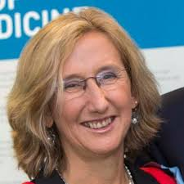




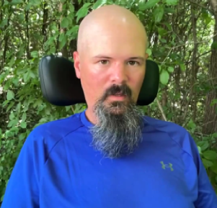
Program Faculty
CHAIR
Prof. Orla Hardiman, BSc, MB, MD, FRCPI, FTCD, MRIA
Professor of Neurology, Trinity College Dublin
Consultant Neurologist, National Neuroscience Centre
Beaumont Hospital
Dublin, Ireland
Prof. Nortina Shahrizaila, DM, PhD, FRCP
Professor of Neurology, Universiti Malaya
Consultant Neurologist, Universiti Malaya Medical Centre
Kuala Lumpur, Malaysia
Marla Calder, BScOT
Occupational Therapist
Stan Cassidy Centre for Rehabilitation
Fredericton, New Brunswick, Canada
Prof. Christopher J. McDermott, PhD, MD, FRCP
Neurologist
University of Sheffield
Sheffield, England, UK
Cathy Cummings, CAE, MBA
Executive Director
International Alliance of ALS/MND Associations
Coldwater, Ontario, Canada
Craig Reyenga
Person living with ALS/MND
Ottawa, Ontario, Canada

Slide 6
Program Faculty Disclosures
Relationships with commercial interests | Prof. Orla Hardiman | Marla Calder | Prof. Christopher J. McDermott | Craig Reyenga | Prof. Nortina Shahrizaila | Cathy Cummings
Research grants | PI Research Ireland Academic Industry Collaboration-PRECISION ALS Co-PI Irish Health Research Board- Clinical Doctoral Award MIRANDA, My Name'5 Doddie Foundation | – | MND Assoc, NIHR, Life Arc, My Name'5 Doddie Foundation | – | ALS Association, Universiti Malaya Matching Grant, Ministry Higher Education Malaysia, Sydney University Southeast Asia Centre | None–
Speakers’ bureaus/ honoraria/ grants | – | – | – | Mitsubishi Tanabe pharmaceutical paid me a small sum to speak at the symposium in Montreal in December. | – | None–
Consulting fees | Biogen, Novartis, Trace, UniQure, Medicinova | – | Verge | – | – | –
Other | – | – | – | I run a website about how to live with ALS. I also sell accessories for mouthpiece ventilators through it. ALSWiki.org | – | –
ALS, amyotrophic lateral sclerosis; MND, motor neuron disease; NIHR, National Institute for Health and Care Research; PI, principal investigator

Slide 7
Learning Objectives
At the end of this program, participants will be better able to:
R
A
C
E
Recognize the early signs and symptoms of ALS/MND across diverse healthcare settings and specialties
Assess clinical features and initiate appropriate investigations (if warranted) without delaying referral
Communicate the need for an urgent onward specialist referral to those with suspected ALS/MND
Expedite referrals — even in the absence of complete diagnostic confirmation — and ensure referral letters clearly communicate key clinical findings to support triage
ALS, amyotrophic lateral sclerosis; MND, motor neuron disease

Slide 8










Who is This Program For?
Rheumatologists
Early career physicians
Ear, Nose & Throat specialists
Healthcare professionals and allied healthcare professionals who may serve as the first point of contact for individuals with early signs/symptoms of ALS/MND, and who play a key role in recognizing suspicious features early and initiating timely referrals to ALS/MND specialists
General neurologists
Neurosurgeons
Orthopedic surgeons
Physiatrists /
rehabilitation physicians
Physiotherapists
Speech language therapists
Occupational therapists
ALS, amyotrophic lateral sclerosis; MND, motor neuron disease

Slide 9
Why Early Recognition of
ALS/MND Matters
ALS, amyotrophic lateral sclerosis; MND, motor neuron disease

Slide 10
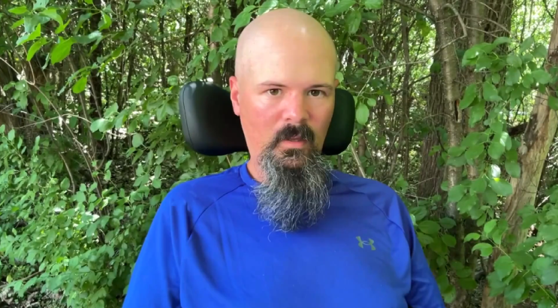
Person with ALS/MND Sharing His Diagnostic Journey
Craig’s story
Click here to view video
Craig Reyenga
Ottawa, Ontario, Canada
ALS, amyotrophic lateral sclerosis; MND, motor neuron disease

Slide 11
ALS/MND Diagnosis is Often Delayed by Over a Year
Pathway to ALS/MND diagnosis from first symptom onset to final diagnosis
Other specialists (e.g., otorhinolaryngologist, orthopedist, rheumatologist, neurosurgeon)
~40%
B
C
~60%
A
Neurologist
Formal diagnosis
First symptom onset noted by patient
First presentation to physician
3 to 6 months
Total 10 to 16 months
Most studies reported a delay of 10–16 months,
although delays of >24 months have also been reported
ALS, amyotrophic lateral sclerosis; MND, motor neuron disease
Adapted from: Richards D, et al. J Neurol Sci. 2020;417:117054.
Notes:
Richards D, Morren JA, Pioro EP. Time to diagnosis and factors affecting diagnostic delay in amyotrophic lateral sclerosis. J Neurol Sci. 2020 Oct 15;417:117054.

Slide 12

One study found a mean interval of over 1.5 years from first symptom to first visit to an ALS/MND multidisciplinary clinic
First symptom timeline
 | A. First symptom to general practitioner visit | B. First symptom to first neurologist | C. First symptom to diagnosis | D. First symptom to multidisciplinary clinic
Months
Mean | 5.5 | 11.2 | 16.0 | 19.1
Median | 3.0 | 8.0 | 13.0 | 14.6
Standard deviation | 6.8 | 8.4 | 9.5 | 11.6
Range | 0–25 | 0–35 | 4–48 | 8–54
N | 31 | 33 | 35 | 35
5.5 months
11.2 months
16.0 months
19.1 months
ALS, amyotrophic lateral sclerosis; MND, motor neuron disease
Galvin M, et al. BMC Health Serv Res. 2015;15:571.
Notes:
Galvin M, Madden C, Maguire S, Heverin M, Vajda A, Staines A, Hardiman O. Patient journey to a specialist amyotrophic lateral sclerosis multidisciplinary clinic: an exploratory study. BMC Health Serv Res. 2015;15:571.

Slide 13





Why Diagnostic Delay in ALS/MND Matters
Delayed access to multidisciplinary ALS/MND care that improves quality of life & survival
Risk of unnecessary interventions (surgical procedures, tests) that can be costly and potentially accelerate the disease
Lost opportunities to access clinical trials and experimental therapies
Diagnostic uncertainty is deeply distressing for individuals and their families/caregivers
Reduced benefit of disease-modifying therapies
Delayed genetic testing for identifying patients eligible for targeted therapies, such as tofersen
Delayed access to devices
that assist with prolonging functional independence (e.g., early non-invasive ventilation can significantly slow the rate of functional decline)
ALS, amyotrophic lateral sclerosis; MND, motor neuron disease
1. Gwathmey KG, et al. Eur J Neurol. 2023;30(9):2595-2601. 2. Richards D, et al. J Neurol Sci. 2020;417:117054. 3. Mitsumoto H, et al. Neurology. 2022;99(2):60-68.
Notes:
Gwathmey KG, Corcia P, McDermott CJ, Genge A, Sennfält S, de Carvalho M, Ingre C. Diagnostic delay in amyotrophic lateral sclerosis. Eur J Neurol. 2023 Sep;30(9):2595-2601.
Mitsumoto H, Kasarskis EJ, Simmons Z. Hastening the Diagnosis of Amyotrophic Lateral Sclerosis. Neurology. 2022 Jul 11;99(2):60-68.

Slide 14

ALS/MND Standard of Care:
The Multidisciplinary Clinic
ALS/MND specialist
Nursing professional
Mental health professional
Dietitian/ nutritionist
Occupational therapist
Respiratory therapist
Physical therapist
Speech language pathologist
Social worker
ALS/MND organization
Persons with ALS/MND are seen approximately every 3 months for evaluation by a multidisciplinary team
Multidisciplinary care respects autonomy and facilitates shared decision-making
Person with ALS/MND & Caregiver/Family
ALS, amyotrophic lateral sclerosis; MND, motor neuron disease
Adapted from: Miller RG, et al. Neurology. 2009;73(15):1227-1233.
Notes:
Miller RG, Jackson CE, Kasarskis EJ, England JD, Forshew D, Johnston W, Kalra S, Katz JS, Mitsumoto H, Rosenfeld J, Shoesmith C, Strong MJ, Woolley SC; Quality Standards Subcommittee of the American Academy of Neurology. Practice parameter update: the care of the patient with amyotrophic lateral sclerosis: multidisciplinary care, symptom management, and cognitive/behavioral impairment (an evidence-based review): report of the Quality Standards Subcommittee of the American Academy of Neurology. Neurology. 2009 Oct 13;73(15):1227-33.

Slide 15



Multidisciplinary Care is Backed by Literature
Multidisciplinary care in ALS/MND extends survival and improves quality of life
Van den Berg JP, et al. Multidisciplinary ALS care improves quality of life in patients with ALS. Neurology. 2005;65(8):1264-7.
Aridegbe T, et al. The natural history of motor neuron disease: assessing the impact of specialist care. Amyotroph Lateral Scler Frontotemporal Degener. 2013;14(1):13-9.
Boylan K, et al; ALS Center Cost Evaluation W/Standards & Satisfaction (Access) Consortium. Prospective study of cost of care at multidisciplinary ALS centers adhering to American Academy of Neurology (AAN) ALS practice parameters. Amyotroph Lateral Scler Frontotemporal Degener. 2015;17(1-2):119-27.
Stephens HE, et al. A Qualitative Study of Multidisciplinary ALS Clinic Use in the United States. Amyotroph Lateral Scler Frontotemporal Degener. 2015;17(1-2):55-61.
Connolly S,, et al. Health and social care costs of managing amyotrophic lateral sclerosis (ALS): an Irish perspective. Amyotroph Lateral Scler Frontotemporal Degener. 2015;16(1-2):58-62.
Stephens HE, et al. Multidisciplinary ALS clinics in the USA: A comparison of those who attend and those who do not. Amyotroph Lateral Scler Frontotemporal Degener. 2015;16(3-4):196-201.
Traynor BJ, et al. Effect of a multidisciplinary amyotrophic lateral sclerosis (ALS) clinic on ALS survival: a population-based study, 1996-2000. J Neurol Neurosurg Psychiatry. 2003;74(9):1258-61.
Chiò A, et al; PARALS. Positive effects of tertiary centres for amyotrophic lateral sclerosis on outcome and use of hospital facilities. J Neurol Neurosurg Psychiatry. 2006;77(8):948-50.
Rooney J, et al. A multidisciplinary clinic approach improves survival in ALS: a comparative study of ALS in Ireland and Northern Ireland. J Neurol Neurosurg Psychiatry. 2015;86(5):496-501.
ALS, amyotrophic lateral sclerosis; MND, motor neuron disease

Slide 16






Quality of Life in ALS/MND is Not Solely Dependent on Physical Function
Frame Shift
Interpersonal relationships
Beauty of surroundings
Exercise
Travel
Work
Faith/spirituality
ALS/MND Diagnosis
“To live is not to just have my physical needs met and be able to breathe. It is the other way around in terms of the Maslow Hierarchy. I need to be able to love, to have belonging, esteem and to be able to contribute, and feel a sense of actualization. That is quality of life for me.”
Bernice You, Person living with ALS/MND and former member of the Alliance´s Patient and Caregiver Advisory Council (PCAC)
ALS, amyotrophic lateral sclerosis; MND, motor neuron disease
Simmons Z. Neurotherapeutics. 2015;12(2):394-402.
Notes:
Many individuals diagnosed with ALS/MND experience a “frame shift” — redefining what brings meaning and joy to their lives
Early diagnosis enables individuals to:
Make critical life decisions, such as where to live or how to plan financially, before function declines
Make informed life decisions that are aligned with future needs (eg, buying a new car may not be an appropriate decision given future mobility challenges)
Simmons Z. Patient-Perceived Outcomes and Quality of Life in ALS. Neurotherapeutics. 2015 Apr;12(2):394-402.

Slide 17

Early Diagnosis Facilitates Access to Clinical Trials
Numerous clinical trials of new and emerging therapies for ALS/MND are ongoing, including:
  Small molecules
  Gene therapies
  Regenerative medicine approaches
The clinical trial pipeline is dynamic, with new agents and modalities entering trials each year
The Clock Is Ticking
Timely referral and diagnosis are critical as most trials require early-stage disease (≤18–24 months of symptom onset) and low disease burden for eligibility
ALS, amyotrophic lateral sclerosis; MND, motor neuron disease
1. Jiang J, et al. Front Pharmacol. 2022;13:1054006. 2. Martinez-Gonzalez L, et al. Expert Opin Investig Drugs. 2023;32(2):141-160. 3. De Marchi F, et al. Expert Rev Neurother. 2025 Jul;25(7):773-789. 4. Rizea RE, et al. Int J Mol Sci. 2024;25(18):9966. 5. Richards D, et al. J Neurol Sci. 2020;417:117054.
Notes:
Jiang J, Wang Y, Deng M. New developments and opportunities in drugs being trialed for amyotrophic lateral sclerosis from 2020 to 2022. Front Pharmacol. 2022 Nov 28;13:1054006.
Martinez-Gonzalez L, Martinez A. Emerging clinical investigational drugs for the treatment of amyotrophic lateral sclerosis. Expert Opin Investig Drugs. 2023 Feb;32(2):141-160.
De Marchi F, Lombardi I, Bombaci A, Diamanti L, Olivero M, Perciballi E, Tornabene D, Vulcano E, Ferrari D, Mazzini L. Recent therapeutic advances in the treatment and management of amyotrophic lateral sclerosis: the era of regenerative medicine. Expert Rev Neurother. 2025 Jul;25(7):773-789.
Rizea RE, Corlatescu AD, Costin HP, Dumitru A, Ciurea AV. Understanding Amyotrophic Lateral Sclerosis: Pathophysiology, Diagnosis, and Therapeutic Advances. Int J Mol Sci. 2024 Sep 15;25(18):9966.

Slide 18

Diagnostic Delays Are Associated with Multiple Specialist Referrals
A retrospective review of 103 persons diagnosed with ALS/MND found:
35%
49%
9%
were seen by ≥2 specialties before being referred to neurology
This rose to almost 50% when those with bulbar-onset disease were considered
were seen by ≥3 specialties before being referred to neurology
Greater number of specialist referrals was significantly associated with greater diagnostic delays
Specialties that patients were commonly referred to prior to diagnosis:
Ear, nose & throat
Neurosurgery
Orthopedics / hand surgery
Musculoskeletal medicine / rheumatology
Stroke
General medicine
Elderly medicine
Gastroenterology / upper gastrointestinal surgery
Physiotherapy
Speech & language therapy
ALS, amyotrophic lateral sclerosis; MND, motor neuron disease
Reynolds SJ, Chhetri SK. Clin Med (Lond). 2024;24(4):100228.
Notes:
Reynolds SJ, Chhetri SK. Specialist referrals and diagnostic delays in motor neurone disease: Mapping patients' journey through hoops and hurdles in healthcare. Clin Med (Lond). 2024 Jul;24(4):100228.

Slide 19
Vast majority have multiple contacts with healthcare professionals prior to an ALS/MND diagnosis
Contacts with Healthcare Professionals Prior to Diagnosis
Based on a retrospective study of 35 people diagnosed with ALS/MND
ALS, amyotrophic lateral sclerosis; MND, motor neuron disease
Galvin M, et al. BMC Health Serv Res. 2015;15:571.
Notes:
42.9% of the patients had 3 contact points before arriving at the mdt clinic

Slide 20
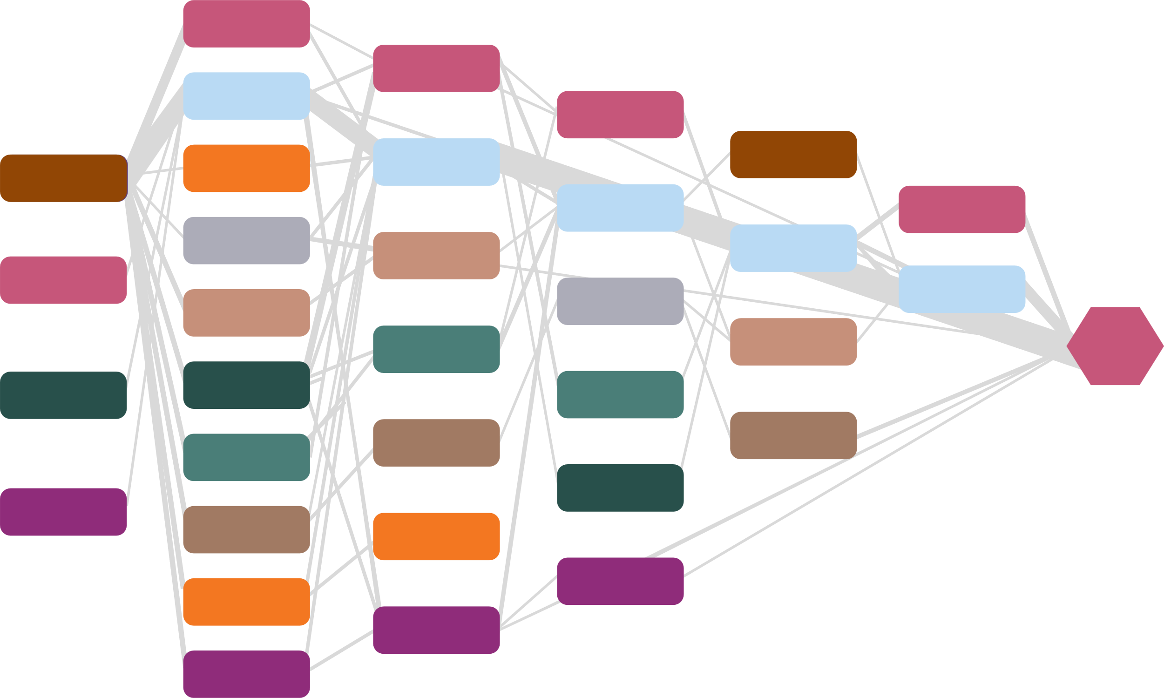
Does Early Review by Neurology Help?
Early review by non-specialist neurologist did not reduce delay to ALS/MND multidisciplinary clinic…But reduced the overall cost of investigation.
Sequence of contacts with health services
Contact 1
Contact 2
Contact 3
Contact 4
Contact 5
Contact 6
Multidisciplinary Clinic
Hospital / Emergency Department
(5)
Neurology (15)
Hospital / Emergency Department (5)
Hospital / Emergency Department
(2)
Rheumatology (2)
Neurology (17)
General practitioner (1)
General practitioner (32)
Neurology (11)
Hospital / Emergency Department
(5)
Ear, Nose & Throat (2)
Other Surgical (1)
Neurology (8)
Hospital / Emergency Department (1)
Ear, Nose & Throat (2)
Neurology (5)
Other Surgical (1)
Orthopedic
(2)
Other Surgical (1)
Multidisciplinary Clinic
Physiotherapy
(1)
Physiotherapy (4)
Orthopedic
(1)
Orthopedic
(5)
Geriatrics (1)
Geriatrics (1)
Physiotherapy (1)
Other (1)
Geriatrics (2)
Chiropractor (1)
Chiropractor (1)
Other (1)
Other (4)
Other (1)
ALS, amyotrophic lateral sclerosis; MND, motor neuron disease
Galvin M, et al. BMC Health Serv Res. 2015;15:571. Galvin M, et al PLoS One. 2017;12(6):e0179796.

Slide 21
Non-ALS Physicians Are Important Links in Determining Diagnostic Timelines for ALS
Non-ALS/MND Clinicians Are Important Links in Determining Diagnostic Timelines for ALS/MND
Symptom onset
~12 months
ALS/MND diagnosis
Tests
ALS/MND drugs
General
neurologist
T
T
T
Initiation of diagnosis quest
General
neurologist
ALS/MND specialist neurologist
Primary, general practitioner
T
T
Multidisciplinary clinic
T
T
T
T
T
T
Clinical trials
T
T
Tests
T
T
Other specialists
Tests
T
T
General
neurologist
Tests
Unnecessary surgeries or treatments
T
T
T
T
Tests
ALS, amyotrophic lateral sclerosis; MND, motor neuron disease; T in a circle indicates that time is required to obtain necessary appointments or test procedures
Arrows indicate the many different paths to reach the diagnosis of ALS/MND. Red thick arrows denote less common paths that often derail the expected paths to diagnosis.
Mitsumoto H, et al. Neurology. 2022;99:60-68.
Notes:
This slide illustrates the critical role that non-ALS/MND clinicians play in determining diagnostic timelines, as their recognition of signs and symptoms and timely referrals can significantly speed up the path to an ALS/MND diagnosis. People with ALS/MND symptoms often consult their primary physician first, while some may consult neurologists and other specialists, such as otolaryngologists, orthopedic surgeons, or neurosurgeons. Arrows indicate the many different paths to reach the diagnosis of ALS/MND. Red thick arrows denote less common paths that often derail the expected paths to diagnosis. Every physician during this process may order tests, including multiple neuroimaging procedures and electrodiagnostic studies (nerve conduction studies and EMGs), which require time. Some patients might undergo inappropriate interventions, resulting in a long delay to a correct diagnosis. Scheduling and general logistics of obtaining appointments take time as well. These waiting periods sum up to create the observed long duration from symptom onset to the diagnosis of ALS/MND.

Slide 22
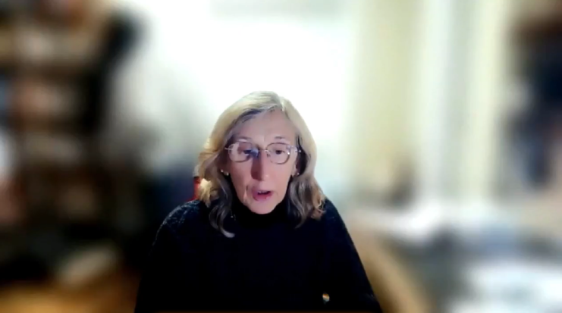
Overcoming Therapeutic Nihilism in ALS/MND
Click here to view video
Prof. Orla Hardiman, BSc, MB, MD, FRCPI, FTCD, MRIA
Dublin, Ireland
ALS, amyotrophic lateral sclerosis; MND, motor neuron disease.

Slide 23



Overcoming Therapeutic Nihilism in ALS/MND
Challenge:
Some healthcare professionals still believe there is little value in early diagnosis or referral due to lack of curative therapies
This mindset — therapeutic nihilism — can delay care and limit access to supportive services
Why This Matters:
Although ALS/MND is still incurable, multidisciplinary care, early intervention, and symptom management improve quality of life and survival
Viewing people with ALS/MND as “hopeless cases” leads to missed opportunities for proactive support (e.g., respiratory, nutritional, psychosocial care)
Disease-modifying therapies offer benefit if initiated early
Call to Action:
Shift the mindset from “nothing can be done” to “there’s much we can do to support”
Refer early to ALS/MND specialists for comprehensive, individualized care
Provide patients and families with realistic hope, not resignation
ALS, amyotrophic lateral sclerosis; MND, motor neuron disease
Maksymowicz S, et al. Neurol Sci. 2022;43(7):4257-4265.
Notes:
Maksymowicz S, Libura M, Malarkiewicz P. Overcoming therapeutic nihilism. Breaking bad news of amyotrophic lateral sclerosis-a patient-centred perspective in rare diseases. Neurol Sci. 2022 Jul;43(7):4257-4265.

Slide 24
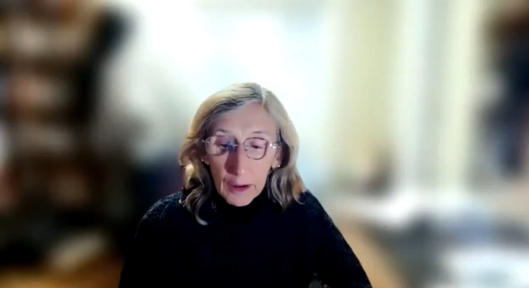
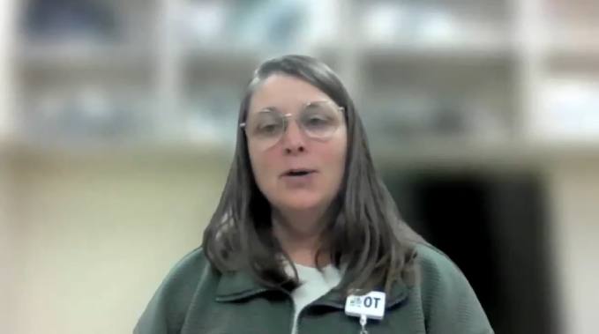
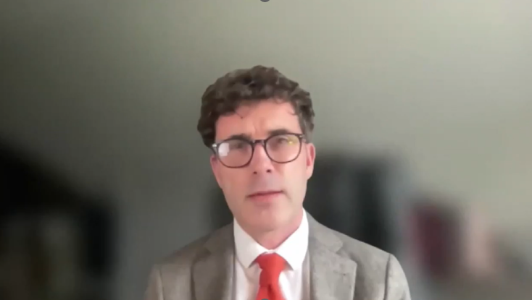
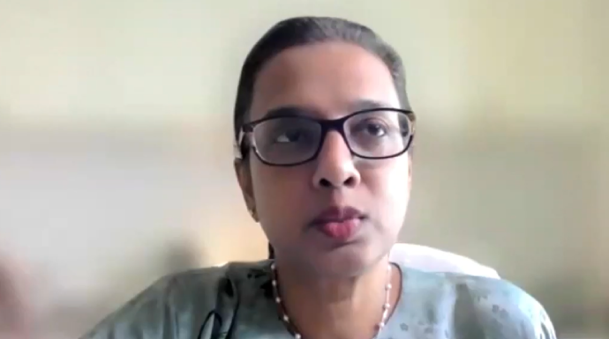
The Cost of Delayed Diagnosis:
Personal Stories from the Faculty
Click here to view video
Click here to view video
Orla Hardiman
Marla Calder
Click here to view video
Click here to view video
Chris McDermott
Nortina Shahrizaila

Slide 25
Early Symptom Roadmap: What to Look For

Slide 26


RED FLAGS: Key Signs, Symptoms,
& Clinical Features of ALS/MND
Head & neck symptoms (bulbar)
Cognitive symptoms
Behavioural changes
Emotional lability (not related to dementia)
Fronto-temporal dementia
35% experience clinically significant cognitive changes
20%–25% present with bulbar onset
Dysarthria (slurred or impaired speech)
Dysphagia (difficulty swallowing)
Excessive saliva
Tongue fasciculations
Respiratory symptoms
Upper body symptoms
Hard-to-explain respiratory symptoms
Shortness of breath on exertion with daily activities
Restricted breathing
Excessive daytime sleepiness or difficulty sleeping
Orthopnea
1%–3% present with respiratory onset
Progressive weakness resulting in asymmetric decline in motor function:
Hand weakness
Limited range of motion and/or difficulty lifting, reaching, or carrying
Difficulty with everyday tasks (e.g., preparing food, opening jars or bottles, starting car, using keys)
Impaired handwriting
Muscle spasms, twitching, fasciculations
Trouble with dressing/hygiene
Lower body symptoms
Progressive asymmetric weakness resulting in decline in gross motor function:
Frequent tripping or stumbling
Difficulty on stairs, getting out of chair, standing on toes, etc.
Foot drags when walking, cannot walk as long/far
Muscle wasting/atrophy
Unintentional/
unexplained weight loss
ALS, amyotrophic lateral sclerosis; MND, motor neuron disease
Adapted from: 1. https://www.alspathways.com/als-overview/. 2. https://als.ca/resource/referals-early-referral-tool/. 3. Masrori P, et al. Eur J Neurol. 2020;27:1918-1929. 4. Verma A, Amyotrophic Lateral Sclerosis [Internet]. Brisbane (AU): Exon Publications. 2021. Chapter 1.

Slide 27







Clinical Features NOT Supportive of ALS/MND Diagnosis
Sensory symptoms/ impairment
Symmetrical signs/symptoms
Pain
Symptom improvements (with or without intervention)
ALS, amyotrophic lateral sclerosis; MND, motor neuron disease
Adapted from: 1. Masrori P, et al. Eur J Neurol. 2020;27:1918-1929. 2. Verma A. Amyotrophic Lateral Sclerosis [Internet]. Brisbane (AU): Exon Publications. 2021. Chapter 1. 3. Motor Neurone Disease Association. The Red Flag Tool. https://www.mndassociation.org/professionals/management-of-mnd/management-by-specific-professions/information-for-gps/red-flag-diagnosis-tool.

Slide 28
Missed Opportunities for Referral in Limb-Onset ALS/MND
Number of specialty referrals by site/symptoms at onset (percentage of patients referred to each specialty shown in brackets)
Over 70% of people with limb-onset ALS/MND (n=62) underwent at least one non-neurology referral, delaying diagnosis
Specialty | All limb onset (N=62) | Arm weakness (N=10) | Hand weakness (N=14) | Leg weakness, altered gait, falls (N=28) | Foot drop (N=6)
Neurosurgery | 13 (21%) | 2 (20%) | 4 (29%) | 6 (21%) | 1 (17%)
Orthopedics | 13 (21%) | 1 (10%) | 4 (29%) | 7 (25%) | 1 (17%)
Musculoskeletal medicine | 8 (13%) | 0 | 5 (36%) | 1 (4%) | 2 (33%)
Stroke | 9 (15%) | 4 (40%) | 2 (14%) | 2 (7%) | 0
General medicine | 6 (10%) | 0 | 1 (7%) | 4 (14%) | 0
Rheumatology | 2 (3%) | 2 (20%) | 0 | 0 | 0
Elderly medicine | 6 (10%) | 2 (20%) | 0 | 4 (14%) | 0
Emergency medicine | 1 (2%) | 0 | 0 | 1 (4%) | 0
Hand surgery | 1 (2%) | 0 | 1 (7%) | 0 | 0
Ear, nose & throat | 3 (5%) | 0 | 0 | 3 (11%) | 0
Upper gastrointestinal surgery | 1 (2%) | 0 | 0 | 1 (4%) | 0
Physiotherapy | 4 (6%) | 1 (10%) | 0 | 2 (7%) | 1 (17%)
Speech & language therapy | 1 (2%) | 0 | 0 | 1 (4%) | 0
Total referrals | 68 | 12 | 17 | 32 | 5
Most frequent referrals were to:
Neurosurgery
Orthopedics
Stroke services
Musculoskeletal medicine
General medicine
Elderly medicine
ALS, amyotrophic lateral sclerosis; MND, motor neuron disease
Reynolds SJ, Chhetri SK. Clin Med (Lond). 2024;24(4):100228.
Notes:
Reynolds SJ, Chhetri SK. Specialist referrals and diagnostic delays in motor neurone disease: Mapping patients' journey through hoops and hurdles in healthcare. Clin Med (Lond). 2024 Jul;24(4):100228.

Slide 29
Missed Opportunities for Referral in Bulbar-Onset ALS/MND
Number of specialty referrals by site/symptoms at onset (percentage of patients referred to each specialty shown in brackets)
67% of all people with bulbar-onset ALS/MND (n=39) were referred to Ear, nose & throat before neurology
Referral rate rose to:
  100% for isolated dysphagia
  75% for those with dysarthria & dysphagia
Specialty | All bulbar onset (N=39) | Dysarthria (N=18) | Dysphagia (N=8) | Dysarthria & dysphagia (N=6)
Ear, nose & throat | 26 (67%) | 8 (44%) | 8 (100%) | 9 (75%)
Stroke | 7 (18%) | 5 (28%) | 0 | 2 (17%)
Upper gastrointestinal surgery | 5 (13%) | 1 (6%) | 3 (8%) | 1 (8%)
Gastroenterology | 3 (8%) | 0 | 3 (38%) | 0
Elderly medicine | 1 (3%) | 0 | 0 | 1 (8%)
Emergency medicine | 1 (3%) | 1 (6%) | 0 | 0
Respiratory | 3 (8%) | 3 (17%) | 0 | 0
Speech & language therapy | 8 (20%) | 4 (22%) | 1 (13%) | 2 (17%)
Breast | 1 (3%) | 0 | 0 | 1 (8%)
Orthopedics | 1 (3%) | 0 | 1 (13%) | 0
Total referrals | 56 | 22 | 16 | 16
Multiple additional referrals:
18% referred to Stroke
13% to Upper gastrointestinal surgery
8% to Gastroenterology
20% eventually seen by Speech & language therapist — often late
Delays occur as patients cycle through multiple specialties before neurology is considered
ALS, amyotrophic lateral sclerosis; MND, motor neuron disease
Reynolds SJ, Chhetri SK. Clin Med (Lond). 2024;24(4):100228.
Notes:
Reynolds SJ, Chhetri SK. Specialist referrals and diagnostic delays in motor neurone disease: Mapping patients' journey through hoops and hurdles in healthcare. Clin Med (Lond). 2024 Jul;24(4):100228.

Slide 30
Early Clues and Red Flags for Rheumatologists
Progressive, painless, asymmetric limb weakness (often distal or proximal), not explained by joint or inflammatory disease
Muscle atrophy in multiple muscle groups, not confined to a single joint
Fasciculations (visible muscle twitching) in limbs or tongue
Hyperreflexia or spasticity in weak/atrophic muscles
Absence of sensory symptoms
Adapted from: 1. Brown RH, Al-Chalabi A. N Engl J Med. 2017;377(2):162-172. 2. Garnier M, et al. Ann Med. 2024;56(1):2398199. 3. Van Es MA. Int Rev Neurobiol. 2024;176:1-47. 4. Siddique N, Siddique T. GeneReviews [Internet]. Updated 2023 Sep 28. 5. Gwathmey KG, et al. Eur J Neurol. 2023;30(9):2595-2601.
Notes:
Brown RH, Al-Chalabi A. Amyotrophic Lateral Sclerosis. N Engl J Med. 2017 Jul 13;377(2):162-172.
Garnier M, Camdessanché JP, Cassereau J, Codron P. From suspicion to diagnosis: exploration strategy for suspected amyotrophic lateral sclerosis. Ann Med. 2024 Dec;56(1):2398199.
Van Es MA. Amyotrophic lateral sclerosis; clinical features, differential diagnosis and pathology. Int Rev Neurobiol. 2024;176:1-47.
Siddique N, Siddique T. Amyotrophic Lateral Sclerosis Overview. GeneReviews [Internet]. Updated 2023 Sep 28.
Gwathmey KG, Corcia P, McDermott CJ, Genge A, Sennfält S, de Carvalho M, Ingre C. Diagnostic delay in amyotrophic lateral sclerosis. Eur J Neurol. 2023 Sep;30(9):2595-2601.

Slide 31



Early Clues and Red Flags for Orthopedic Surgeons & Neurosurgeons
Progressive weakness and atrophy not explained by a single nerve or root distribution
Profound weakness and atrophy in multiple nerve distributions, especially if bilateral
Fasciculations in hand/forearm muscles
Hyperreflexia in atrophic muscles
A survey of American Society for Surgery of the Hand members found that 11% reported performing nerve decompression surgery on patients later diagnosed with ALS/MND¹
Absence of pain and sensory symptoms
Failure to improve / continued progression after decompressive surgery or other intervention
ALS, amyotrophic lateral sclerosis; MND, motor neuron disease
1. Thomson CG, et al. J Hand Surg Am. 2023;48(8):822-826.
Notes:
Thomson CG, Hutchinson PR, Stern PJ. Misdiagnosis in Amyotrophic Lateral Sclerosis. J Hand Surg Am. 2023 Aug;48(8):822-826.

Slide 32
Early Clues and Red Flags for General Neurologists
Progressive, asymmetric weakness not attributable to a single nerve or root distribution
Often starts in a limb (eg, foot drop, weak grip) or with bulbar symptoms (dysarthria, dysphagia, tongue fasciculations)
Absence of pain and sensory symptoms
Unexplained, unintentional weight loss
No improvement after peripheral nerve surgery (e.g., carpal/cubital tunnel release), immunotherapy (in cases misdiagnosed as immune-mediated neuropathies), or other interventions

Slide 33


Early Clues and Red Flags for Ear, Nose & Throat Specialists and Speech Language Therapists
Dysarthria (slurred or impaired speech)
Dysphagia (difficulty swallowing) to liquids
Excessive saliva (sialorrhea)
Tongue wasting and fasciculations
Absence of pain and sensory symptoms

Slide 34

Early Clues and Red Flags for Early Career Physicians
Unexplained progressive, painless weakness
Unexplained dysphagia with dysarthria
Unexplained, unintentional weight loss
Absence of sensory symptoms
No response to conventional therapies

Slide 35



Early Clues and Red Flags for Physiatrists / Rehabilitation Physicians & Physiotherapists
Progressive, asymmetric weakness:
Often starts in a limb or with bulbar symptoms (dysarthria, dysphagia, tongue fasciculations)
Absence of pain and sensory symptoms
Functional Clues
Disproportionate muscle atrophy that does not follow a typical peripheral nerve or root distribution
Frequent tripping or stumbling
Difficulty on stairs, getting out of chair, standing on toes, etc.
Foot drags when walking, cannot walk as long/far
Unexplained, unintentional weight loss
Failure to improve / worsening function despite standard rehabilitation interventions

Slide 36

Early Clues and Red Flags for Occupational Therapists
Progressive, painless weakness resulting in asymmetric decline in motor function:
Hand weakness
Limited range of motion and/or difficulty lifting, reaching, or carrying
Difficulty with everyday tasks (e.g., preparing food, opening jars or bottles, starting car, using keys)
Impaired handwriting
Muscle spasms, twitching, fasciculations
Trouble with dressing/hygiene

Slide 37


Case Scenario 1: ALS/MND or Not?
38-year-old male presents with a 3-month history of progressive weakness in his right hand
He reports frequent muscle cramps and fasciculations in the right forearm
He reports no pain or sensory changes
He notes visible muscle wasting in the right hand muscles
Examination findings:
Marked atrophy, fasciculations, and hyperreflexia in the right upper limb
Positive Babinski sign
No sensory deficits
Discussion
Would you suspect ALS/MND?
Would you refer this patient to an ALS/MND specialist now?
ALS, amyotrophic lateral sclerosis; MND, motor neuron disease
Notes:
NOTE: This clinical scenario would be highly suggestive of ALS/MND due to the presence of characteristic features such as progressive weakness in one limb (right hand), no pain or sensory changes, fasciculations, etc.

Slide 38

Case Scenario 2: ALS/MND or Not?
52-year-old woman presents with a 4-month history of progressive bilateral hand weakness and numbness
She describes nocturnal paresthesias, intermittent pain, and hand clumsiness
She reports hand stiffness and difficulty gripping objects
Examination findings:
Mild thenar atrophy
Reduced sensation in the median nerve distribution
Hyporeflexia in the upper limbs
No fasciculations
Discussion
Would you suspect ALS/MND?
Would you refer this patient to an ALS/MND specialist now?
ALS, amyotrophic lateral sclerosis; MND, motor neuron disease
Notes:
NOTE: This clinical scenario is unlikely to be ALS/MND due to several features that are not consistent with the disease such as bilateral hand weakness & numbness, nocturnal paresthesias, intermittent pain, reduced sensation, no fasciculations, etc.

Slide 39

Case Scenario 3: ALS/MND or Not?
41-year-old woman presents with a 3-month history of slurred speech and difficulty swallowing liquids
Her voice has become nasal, and she sometimes chokes when eating or drinking
She reports no pain or limb weakness
She has unintentionally lost 3 kg due to eating difficulties
Examination findings:
Dysarthria and dysphonia on speaking
Weakness and atrophy of the tongue, with visible fasciculations
Gag reflex diminished; brisk jaw jerk
No limb weakness or sensory deficits
Discussion
Would you suspect ALS/MND?
Would you refer this patient to an ALS/MND specialist now?
ALS, amyotrophic lateral sclerosis; MND, motor neuron disease
Notes:
NOTE: This clinical scenario would be highly suggestive of bulbar-onset ALS/MND due to the presence of characteristic features such as progressive dysarthria, dysphagia, tongue atrophy with fasciculations, etc.

Slide 40
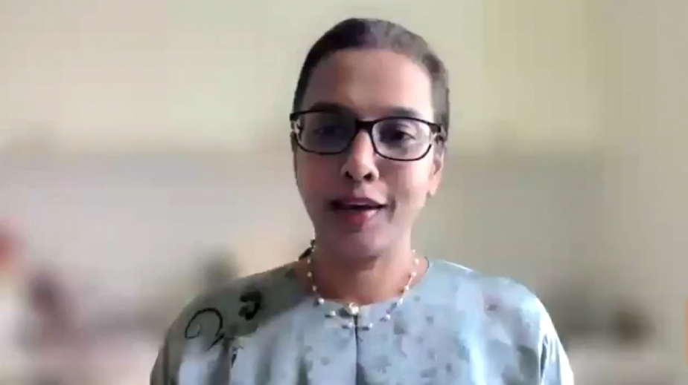
RECAP: When to Suspect ALS/MND and Refer
Click here to view video
Prof. Nortina Shahrizaila, DM, PhD, FRCP
Kuala Lumpur, Malaysia
ALS, amyotrophic lateral sclerosis; MND, motor neuron disease

Slide 41
RECAP: When to Suspect ALS/MND and Refer
Progressive, painless loss of function in speech, mobility, arms, legs, hands, etc., without an obvious explanation
Unexpected, unexplained, weight loss with breathlessness
If it’s progressive and doesn't really fit within your usual area of practice — DON’T WAIT! Refer immediately to an ALS/MND specialist.
ALS, amyotrophic lateral sclerosis; MND, motor neuron disease

Slide 42
Assessment and Investigations Should Never Delay Referral When ALS/MND is Suspected

Slide 43
Diagnosing ALS/MND
ALS/MND is diagnosed through a combination of:
Clinical assessment
  Detailed personal history of symptom development and family history of neuromuscular disease
  Systemic neurological examination to identify upper and lower motor neuron dysfunction
Exclusion of other potential conditions
ALS/MND is a clinical diagnosis, often described as a "diagnosis of exclusion," meaning no single test can definitively rule it in or out
EMG can support the diagnosis of ALS/MND, but referral to an ALS/MND specialist should not be delayed while awaiting results!
ALS, amyotrophic lateral sclerosis; EMG, electromyography; MND, motor neuron disease
Van Es MA. Int Rev Neurobiol. 2024;176:1-47.
Notes:
Van Es MA. Amyotrophic lateral sclerosis; clinical features, differential diagnosis and pathology. Int Rev Neurobiol. 2024;176:1-47.

Slide 44
Diagnostic Tests May Help Rule Out Other Conditions But Should Never Delay Referral
Tests that can help rule out other potential causes of symptoms:
Electromyography
Nerve conduction studies
Magnetic resonance imaging
Genetic testing
Lumbar puncture
Lab tests
Can help exclude muscle diseases that may mimic ALS/MND
Can help rule out neuropathies that mimic ALS/MND
Can help rule out myelopathies and radiculopathies that mimic ALS/MND
Basic blood work and other lab tests can rule out B12 deficiency, thyroid issues, human immunodeficiency virus (HIV), human T-cell lymphotropic virus type 1, West Nile virus, etc.
If you feel the need to order additional tests while awaiting referral, that’s fine — but the results should never delay referral to an ALS/MND specialist if the disease is suspected based on signs/symptoms
ALS, amyotrophic lateral sclerosis; MND, motor neuron disease
1. Hardiman O, et al. Nat Rev Dis Primers. 2017;3:17071. 2. Brown RH, Al-Chalabi A. N Engl J Med. 2017;377(2):162-172. 3. Kiernan MC, et al. Lancet. 2011;377(9769):942-955.
Notes:
Hardiman O, Al-Chalabi A, Chio A, Corr EM, Logroscino G, Robberecht W, Shaw PJ, Simmons Z, van den Berg LH. Amyotrophic lateral sclerosis. Nat Rev Dis Primers. 2017 Oct 5;3:17071.
Brown RH, Al-Chalabi A. Amyotrophic Lateral Sclerosis. N Engl J Med. 2017 Jul 13;377(2):162-172.
Kiernan MC, Vucic S, Cheah BC, Turner MR, Eisen A, Hardiman O, Burrell JR, Zoing MC. Amyotrophic lateral sclerosis. Lancet. 2011 Mar 12;377(9769):942-55.

Slide 45
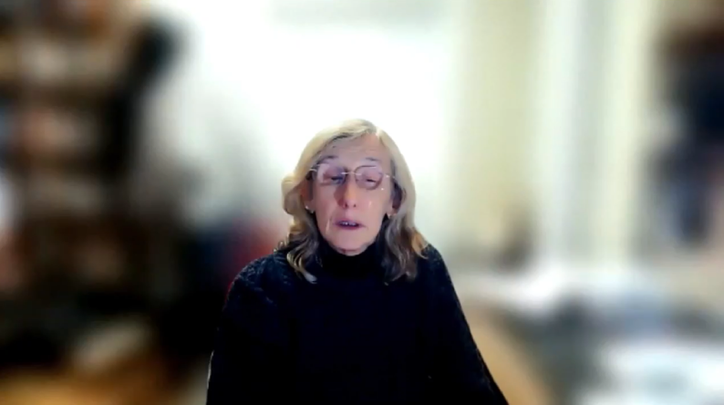
Avoid Diagnostic Pitfalls: Prioritize Urgent Referrals
Click here to view video
Prof. Orla Hardiman, BSc, MB, MD, FRCPI, FTCD, MRIA
Dublin, Ireland

Slide 46




Avoid Diagnostic Pitfalls: Prioritize Urgent Referrals
ALS/MND is a clinical diagnosis of exclusion — no diagnostic test can definitively confirm it
Act on clinical suspicion — do not “hang on” to patients waiting for confirmatory signs / test results
Do not delay referral while awaiting:
  Electromyography (EMG) – abnormalities may be absent, especially in bulbar disease
  Magnetic resonance imaging (MRI) or bloodwork – useful to rule out mimics but should not delay referral
  Be mindful of long wait times for scans (2–3 months or more in some countries)
Best practice: Refer before electromyography and other diagnostic tests are complete to avoid delayed diagnosis
ACT
ALS, amyotrophic lateral sclerosis; MND, motor neuron disease

Slide 47
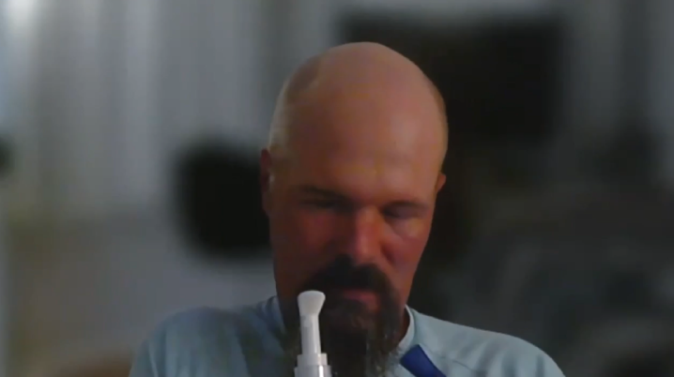
Craig’s MRI Maze: A Journey Through Missed Opportunities and Delayed Referral
Key Message
When ALS/MND is suspected, general neurologists should refer promptly to an ALS/MND specialist clinic — rather than delay with stepwise testing. Time matters!
Click here to view video
Craig Reyenga
Ottawa, Ontario, Canada
ALS, amyotrophic lateral sclerosis; MND, motor neuron disease; MRI, magnetic resonance imaging

Slide 48

Faculty Perspective:
Frustration with Referral Delays
Key Message
When ALS/MND is suspected, refer promptly to an ALS/MND specialist clinic — rather than delay with stepwise testing. Time matters!
Click here to view video
Prof. Christopher J. McDermott, PhD, MD, FRCP
Sheffield, England, UK
ALS, amyotrophic lateral sclerosis; MND, motor neuron disease

Slide 49
Initiating Timely and Effective Referrals:
When, How, and Where

Slide 50







When to Refer
Referral to an ALS/MND clinic/specialist should occur:
  …as soon as ALS/MND is suspected
  …prior to the completion of diagnostic testing
  …in the absence of a definite diagnosis
ALS, amyotrophic lateral sclerosis; MND, motor neuron disease
ReferALS Early Referral Tool. July 25, 2024. https://als.ca/resource/referals-early-referral-tool/ Accessed July 9, 2025.

Slide 51


How to Refer
Clearly document:
  Symptom timeline
  Functional impact (e.g., speech, mobility, hand use)
  Neurological findings
Use language that conveys urgency:
  Progressive, painless loss of function (e.g., speech, mobility, arm, leg) with no clear explanation
  Unexplained weight loss with breathlessness and no obvious cause
  “Clinical suspicion for ALS/MND”
ALS, amyotrophic lateral sclerosis; MND, motor neuron disease
Adapted from: ReferALS Early Referral Tool. July 25, 2024. https://als.ca/resource/referals-early-referral-tool/ Accessed July 9, 2025.

Slide 52
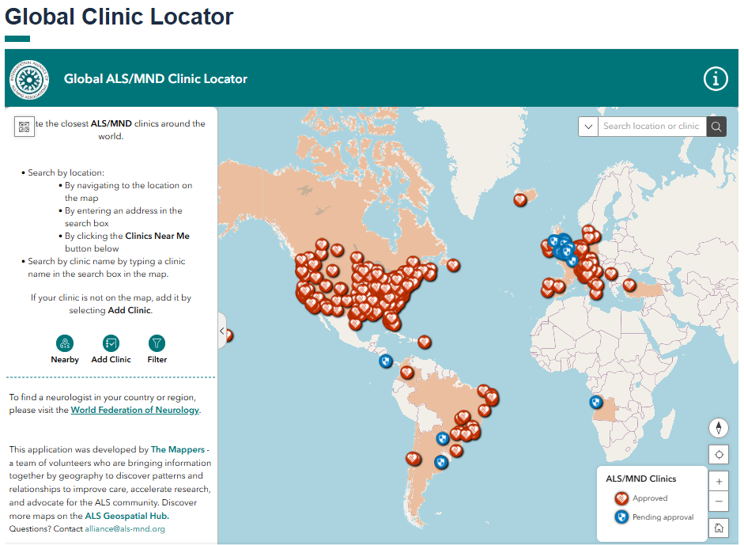


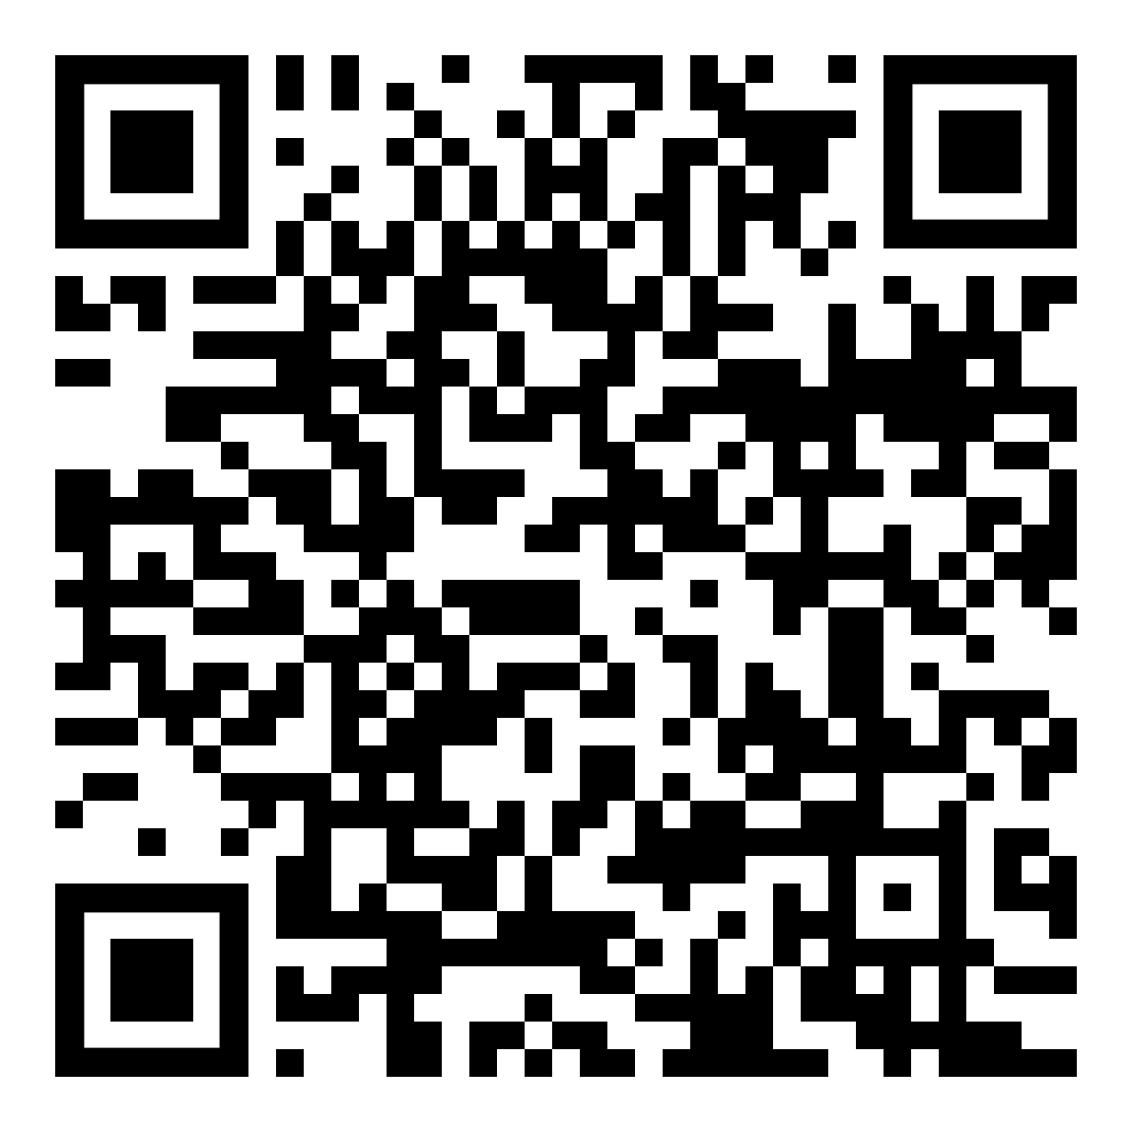
Where to Refer
The ALS/MND Global Clinical Locator is continually updated and expanded as new clinics/specialists are identified.
Scan the QR code to access the webpage.
ALS, amyotrophic lateral sclerosis; MND, motor neuron disease
https://www.als-mnd.org/support-for-pals-cals/clinical-care/global-clinic-locator/

Slide 53
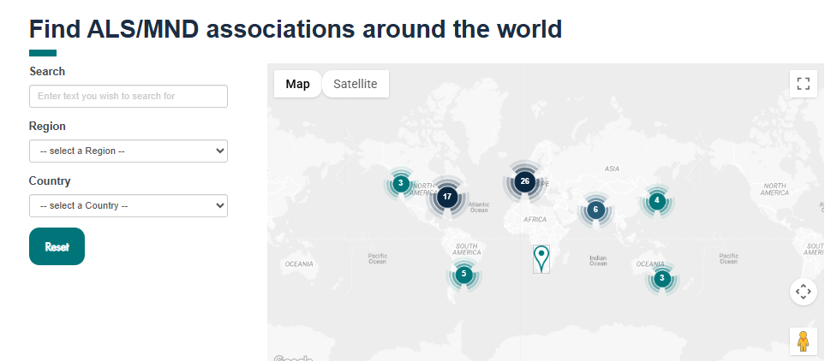
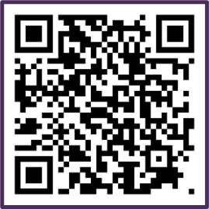
What if There is No ALS/MND Specialist in Your Region?
Alliance member organization are valuable resources for region-specific information
When no specialist is available locally, people are often referred to the member map (different from clinic locator)
In countries without an ALS/MND organization, connect via the member map to a nearby country or a country where the person has relatives to learn about available resources
Scan the QR code to access the webpage.
ALS, amyotrophic lateral sclerosis; MND, motor neuron disease

Slide 54
Communicating Diagnostic Uncertainty and the Need for Specialist Referral

Slide 55

Acknowledge Diagnostic Uncertainty and Patient Distress
Diagnostic uncertainty can be deeply distressing for patients
Prolonged uncertainty leads to frustration, anxiety, and fear about the future, particularly as the progressive nature of symptoms becomes apparent without a clear explanation or plan of action
Acknowledge the seriousness of the problem and validate that this is a difficult time for the patient
Frame the referral as a way to address and mitigate this diagnostic uncertainty
What you could say
“I understand how difficult it is not to have answers yet — this is understandably a very stressful time. I’d like to refer you to a specialist who can help clarify what’s going on and guide next steps…. This specialist will be able to see you in about 2–6 weeks.”

Slide 56
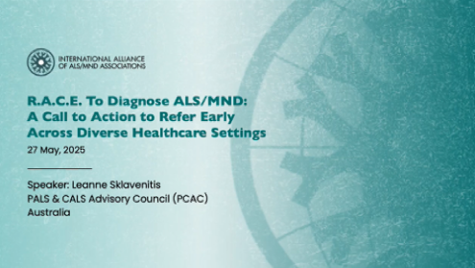
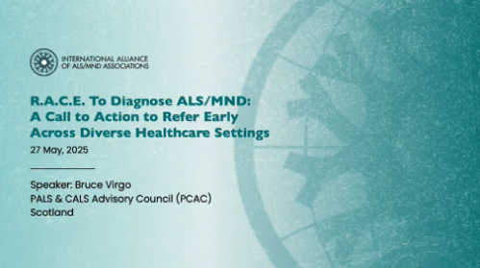
From Diagnostic Uncertainty to Clarity: Insights from the Voices of People Living with ALS/MND
Click here to view video
Click here to view video
Leanne Sklavenitis, Australia
Bruce Virgo, Scotland
ALS, amyotrophic lateral sclerosis; MND, motor neuron disease

Slide 57
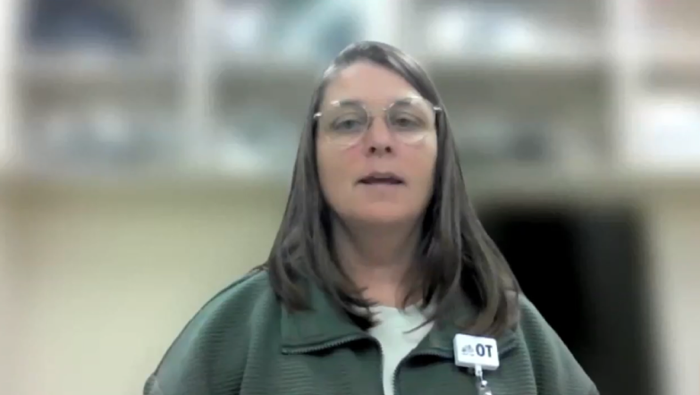
What if the Patient Asks: “Could this be ALS/MND?”
Click here to view video
Marla Calder, BScOT
Occupational therapist, Fredericton, New Brunswick, Canada
ALS, amyotrophic lateral sclerosis; MND, motor neuron disease

Slide 58

What if the Patient Asks: “Could this be ALS/MND?”
What you could say
Be honest when symptoms are unclear
Emphasize commitment to explore further and arrange next steps
Tailor response based on patient rapport and trust
Clarify your role: not to diagnose ALS/MND, but to support referral to a specialist who can
Reassure patients they are not alone in the process
“We don’t know exactly what’s going on but we’ll explore this together and make sure you’re connected with the right specialist who can figure out what’s going on. You don’t have to go through this alone.”
“This is one of the possibilities we’re considering, but I would like to refer you to a specialist who is best equipped to do further testing and who may be able to provide you with better care and support for your symptoms.”
Honesty, support, and clear referral pathways help patients feel heard and reassured
ALS, amyotrophic lateral sclerosis; MND, motor neuron disease

Slide 59
What NOT to Communicate
Avoid giving a diagnosis of ALS/MND
Do not feel compelled to communicate the possibility of ALS/MND
Patients should be referred to an ALS/MND specialist for confirmation and communication of the diagnosis
  If the diagnosis is not delivered appropriately, the effects can be devastating, leaving patients with a sense of abandonment, reducing their quality of life, and destroying the patient–provider relationship
Do not give a prognosis!
Disease progression in ALS/MND is highly variable
Premature prognostic statements can cause unnecessary distress and lead to loss of hope or disengagement from care
Prognosis discussions should be reserved for ALS/MND specialists who are equipped to provide nuanced, individualized guidance
ALS, amyotrophic lateral sclerosis; MND, motor neuron disease
O'Connell C, et al. Amyotroph Lateral Scler Frontotemporal Degener. 2025;26(1-2):5-14.
Notes:
O'Connell C, Kavanaugh MS, Cummings C, Genge A. How to break the news in amyotrophic lateral sclerosis/motor neuron disease: practical guidelines from experts. Amyotroph Lateral Scler Frontotemporal Degener. 2025 Feb;26(1-2):5-14.

Slide 60

Key Take-Home Messages
Early recognition and referral improves survival and quality of life
ALS/MND is a progressive disease, where every month counts — early diagnosis enables access to multidisciplinary care, disease-modifying therapies, clinical trials, symptom management, and supportive care
If it’s progressive and doesn’t fit — REFER
Progressive, painless loss of function or unexplained weight loss with breathlessness should raise red flags — timely referral to an ALS/MND specialist is essential
Don’t delay referral for testing
ALS/MND is a clinical diagnosis of exclusion; diagnostic tests can support but should not delay referral
Overcome therapeutic nihilism — there is much we can do
While ALS/MND remains incurable, multidisciplinary clinics offer proactive, patient-centred care that supports quality of life
Early referral offers patients and families a path forward — not just a diagnosis
ALS, amyotrophic lateral sclerosis; MND, motor neuron disease

Slide 61
Call to Action
R
A
C
E
Assess clinical features & initiate appropriate diagnostic testing (if feasible)
Recognize the Red Flags
Communicate the need for referral
Expedite referral — don’t wait for confirmatory testing
Assessment & testing should not delay referral!
Frame referral as a positive next step toward clarity and support
Emphasize “progressive, painless loss of function” on referral letters

Slide 62



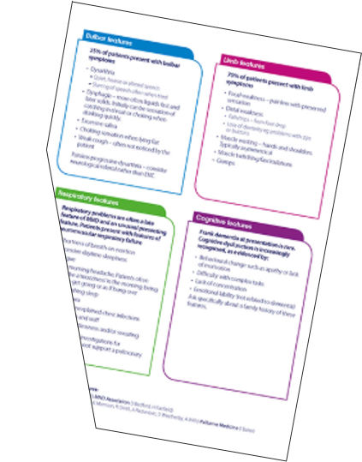
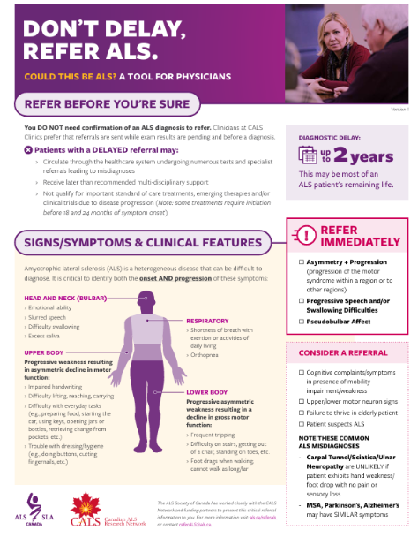
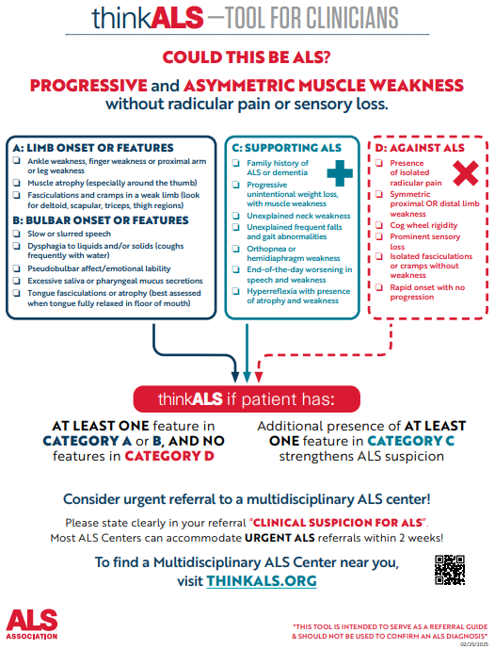
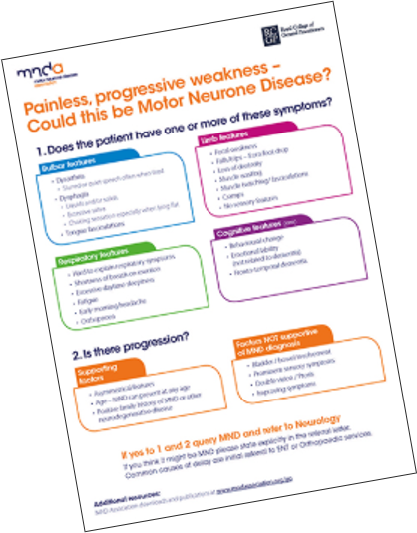
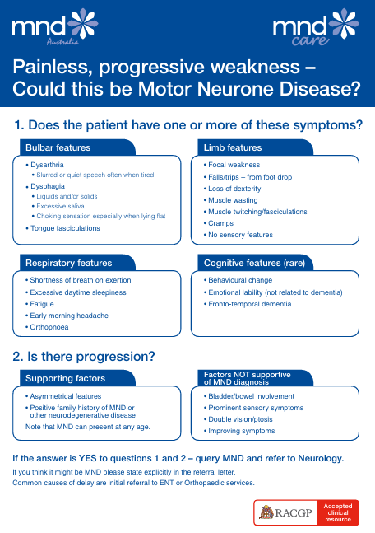
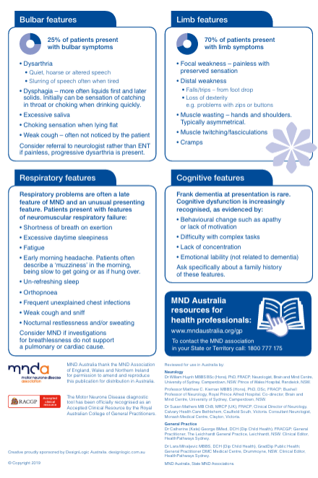
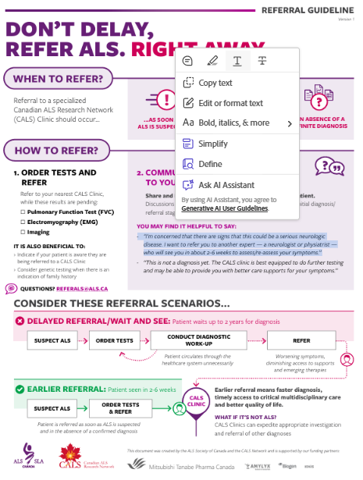
Resources
ReferALS Early Tool
ThinkALS Tool
The MND Red Flag Tool
The MND
Red Flag Tool – Australia
https://als.ca/resource/referals-early-referral-tool/
https://www.als.org/thinkals/thinkals-tool
https://www.mndassociation.org/professionals/management-of-mnd/management-by-specific-professions/information-for-gps/red-flag-diagnosis-tool
https://www.mndaustralia.org.au/mnd-connect/for-health-professionals-service-providers/diagnosing-mnd
ALS, amyotrophic lateral sclerosis; MND, motor neuron disease

Slide 63

Questions
What were your key take-aways from this program?
What will you do differently in your practice based on your participation in this program?
Any other questions?

